Slide 1

BUILDING AN EVANGELISTIC
CHURCH CULTURE

Slide 2

Building an Evangelistic Church Culture
Focused prayer.

Slide 3
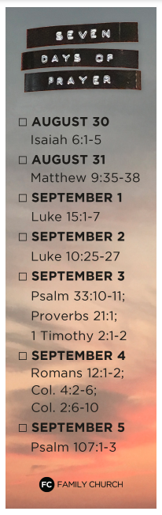


Slide 5
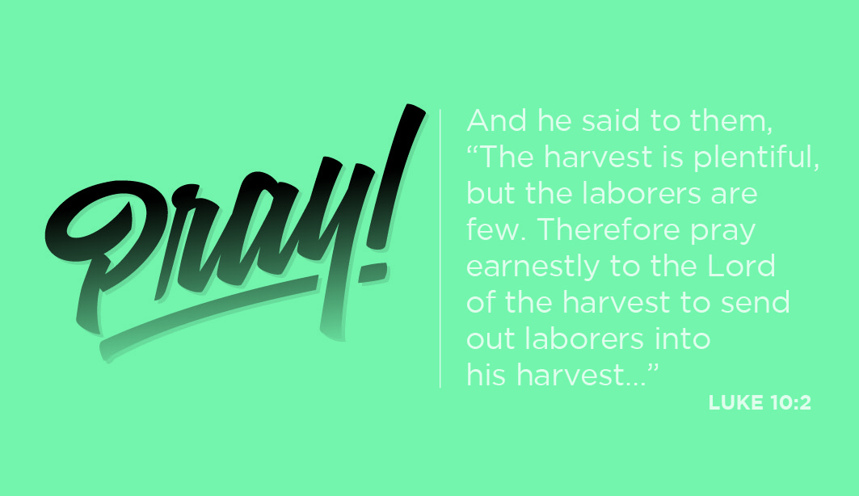
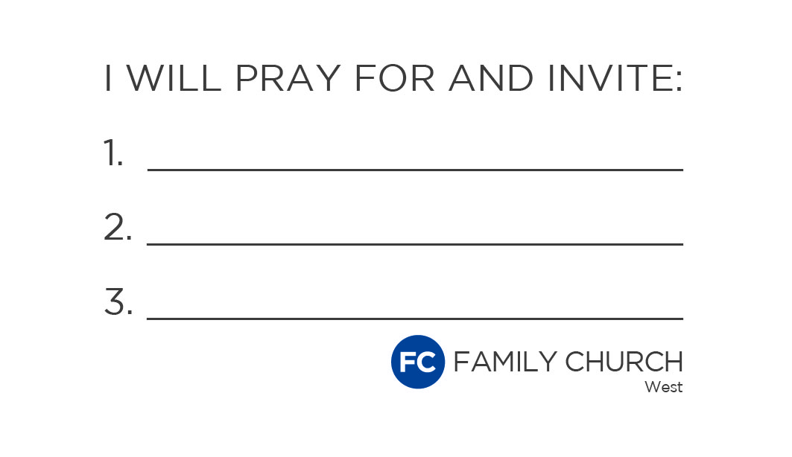

Slide 6
Building an Evangelistic Church Culture
Choose a gospeling tool.

Slide 8
Building an Evangelistic Church Culture
Train your people to use the tool.

Slide 9
Building an Evangelistic Church Culture
Engage with far from God people.

Slide 10
Building an Evangelistic Church Culture
Emphasize rapid obedience.

Slide 11
Building an Evangelistic Church Culture
Coordinate the air war and the ground war.

Slide 12
Building an Evangelistic Church Culture
Create “bottleneck conversations.”

Slide 13
Building an Evangelistic Church Culture
Involve student ministry and children’s ministry.

Slide 14
Building an Evangelistic Church Culture
Collect stories.

Slide 15
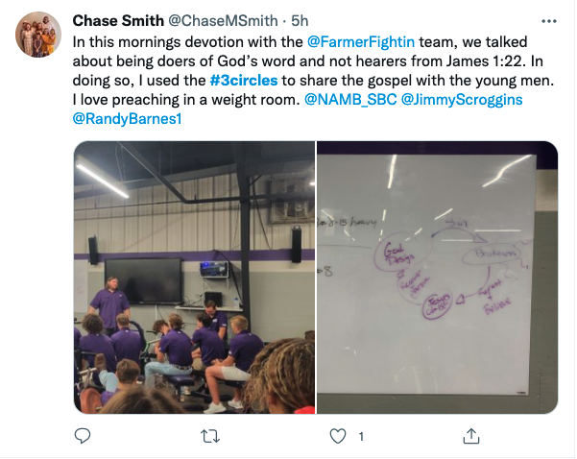

Slide 16
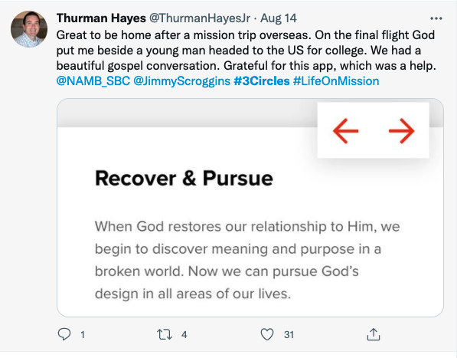

Slide 17



Slide 18
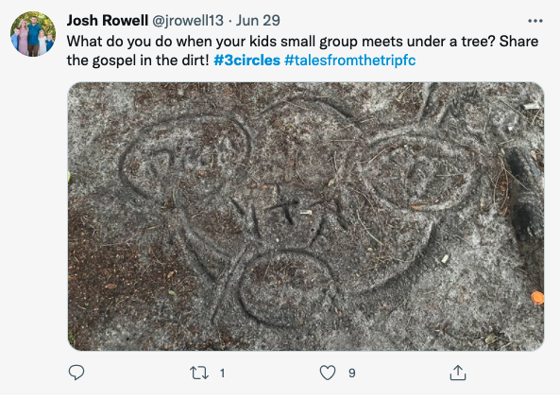
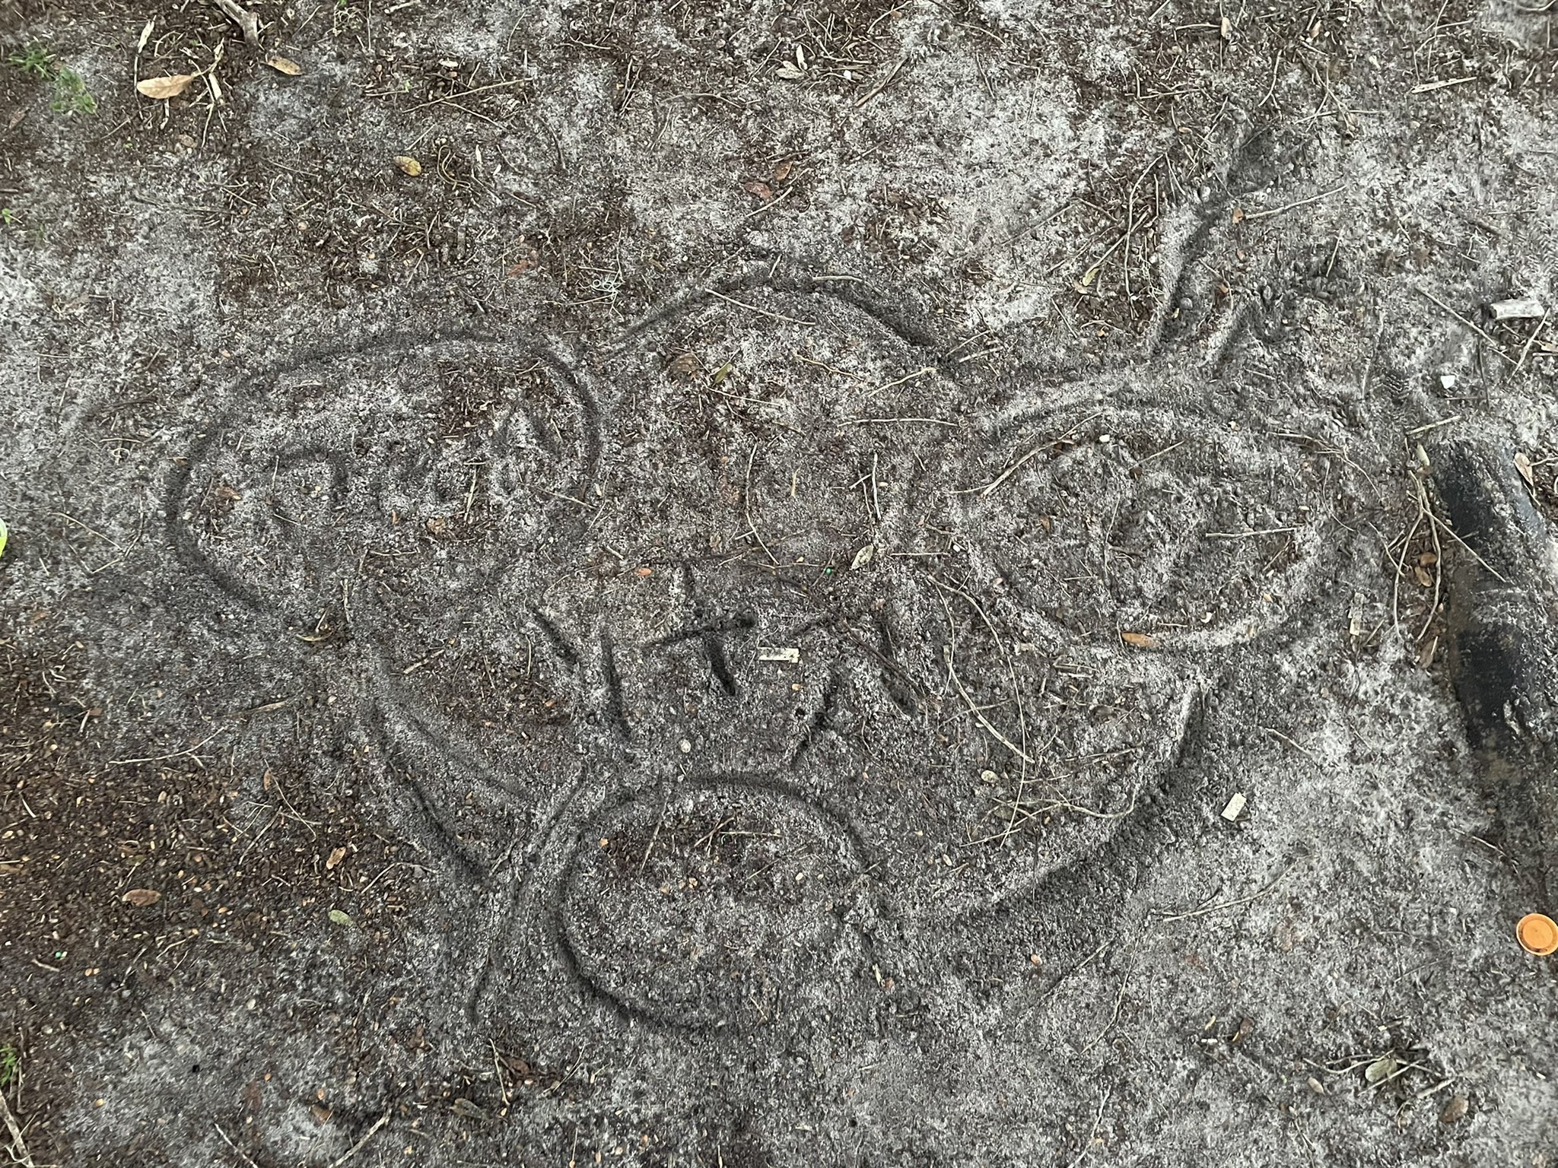

Slide 19
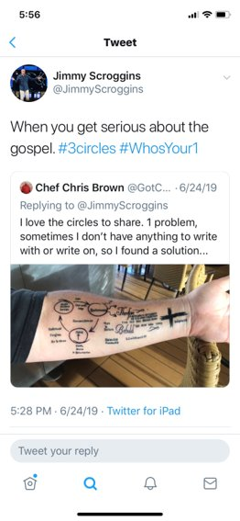

Slide 20


Slide 21
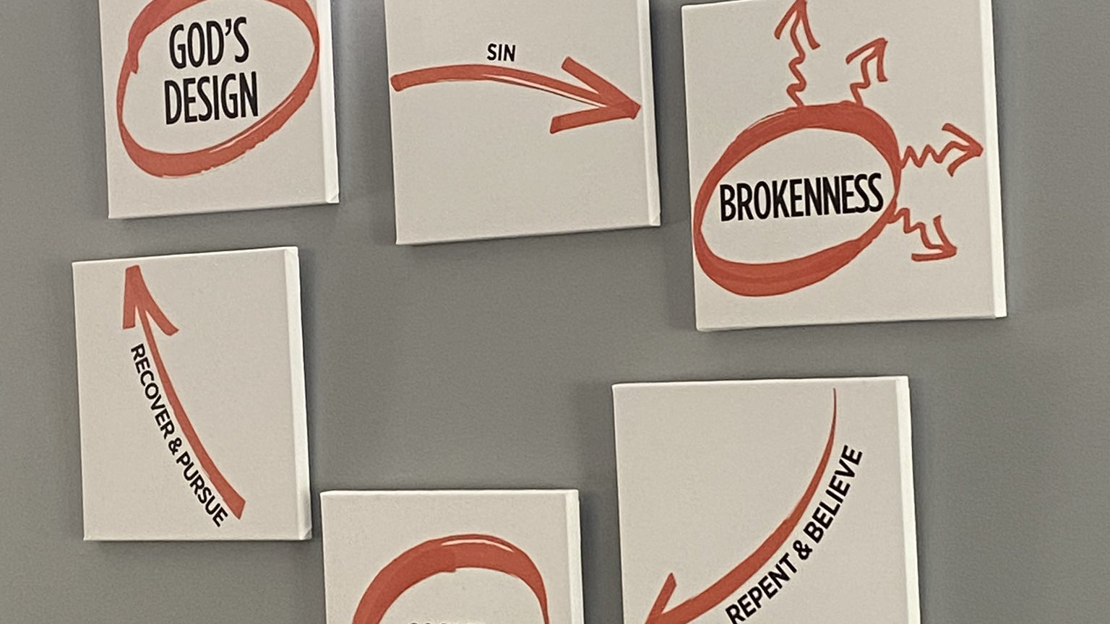

Slide 22
Building an Evangelistic Church Culture
Celebrate God stories.

Slide 23
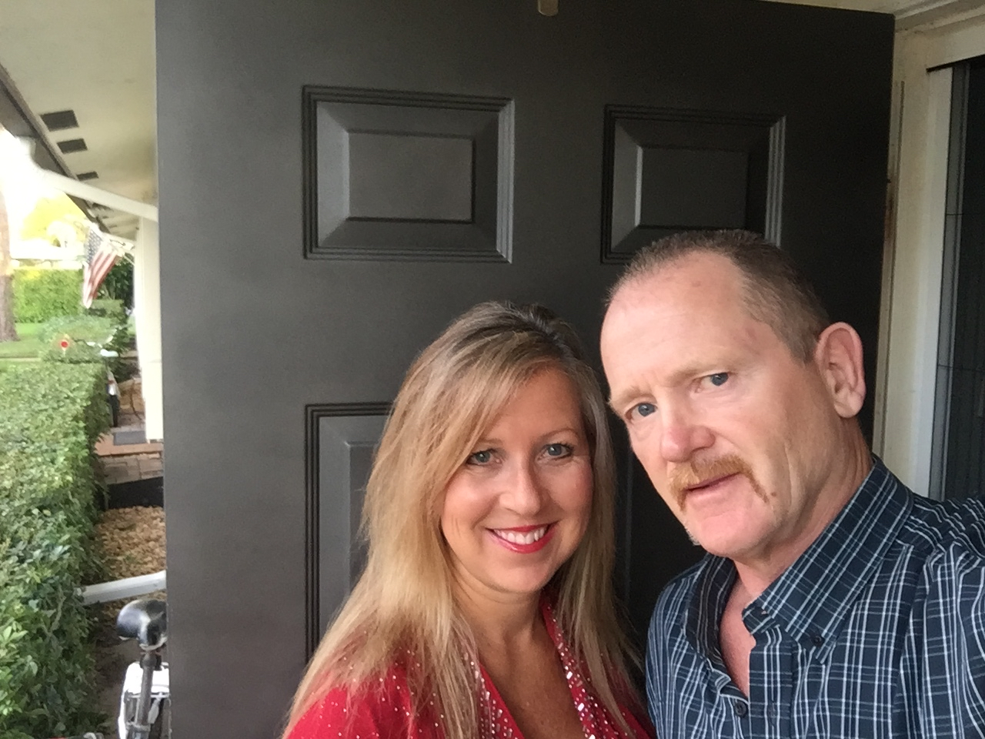
PAT & CORI THOMPSON

Slide 24

MATT & JANELLE STARK

Slide 25
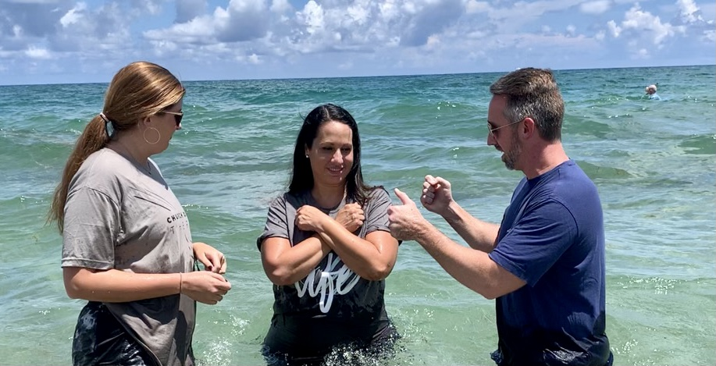
KIMMIE CRUZ

Slide 26
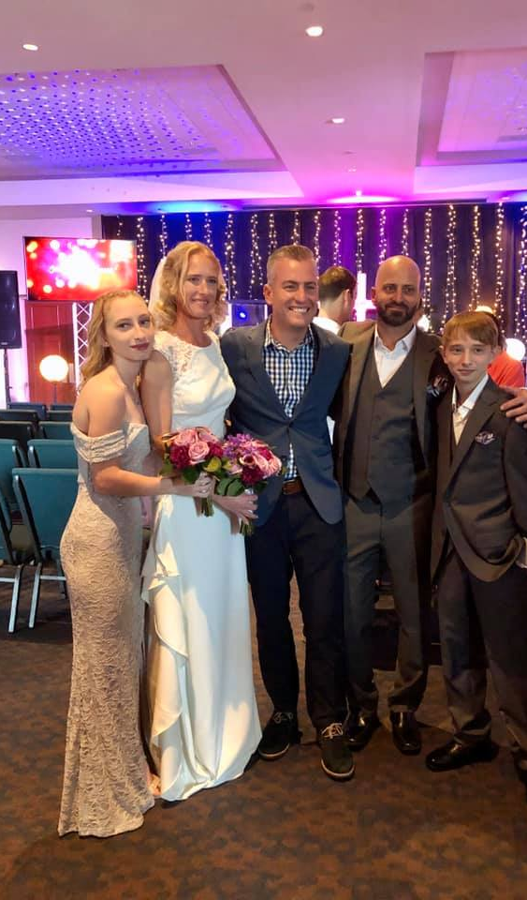
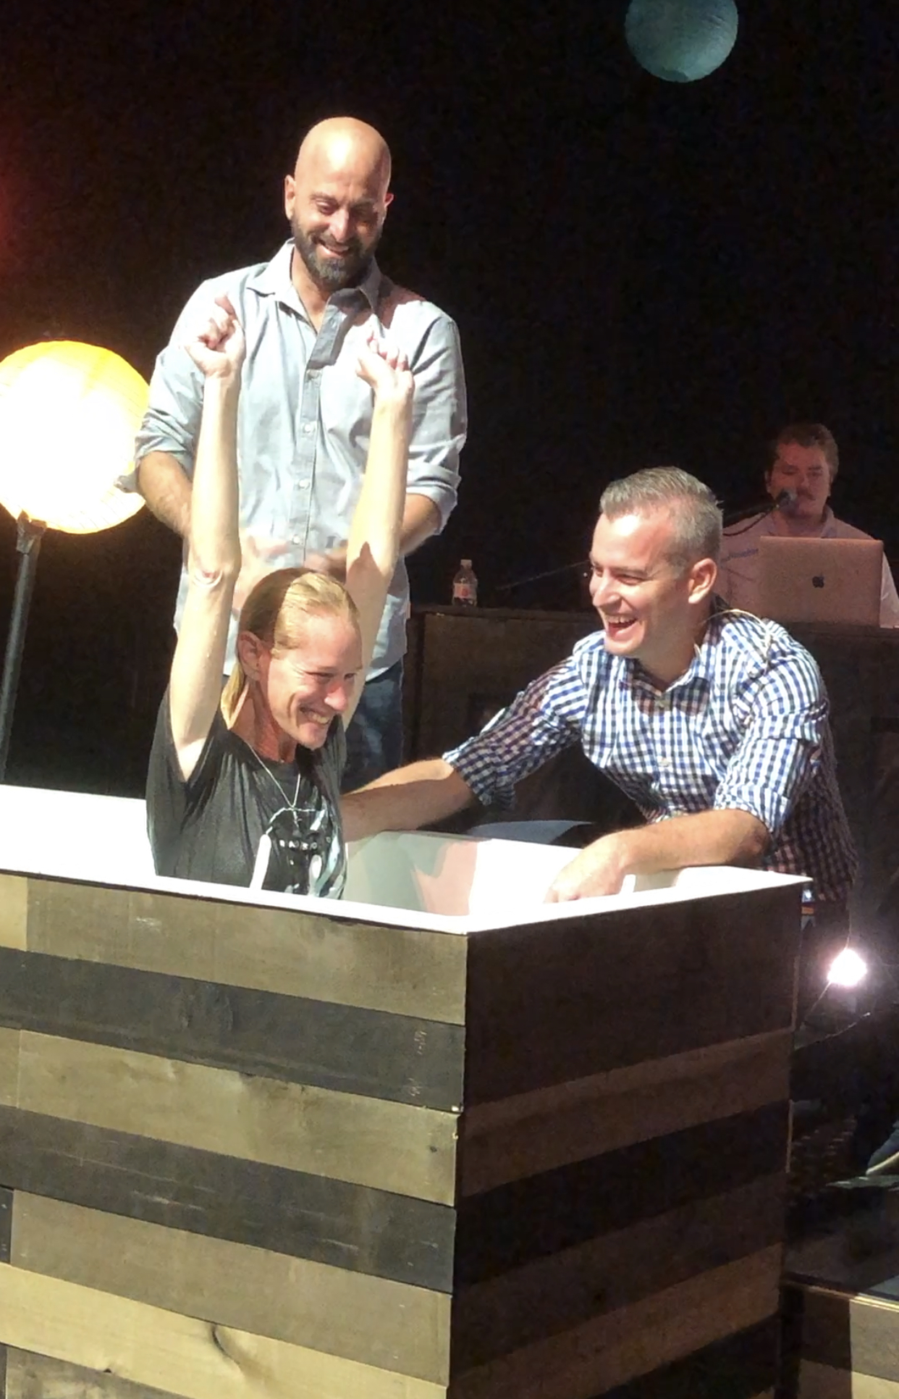
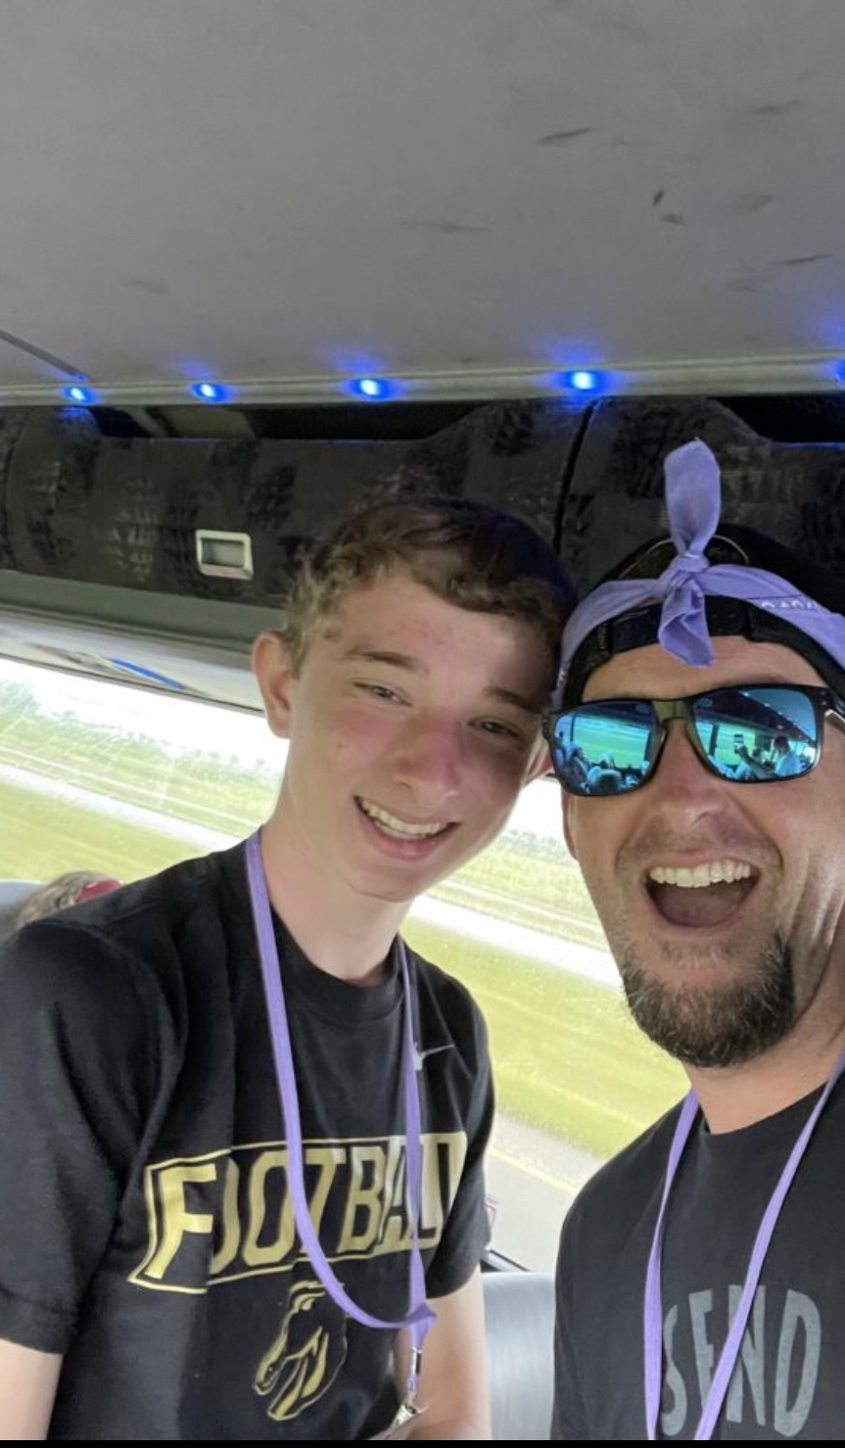
JOEY & REBECCA SCHOPP

Slide 27
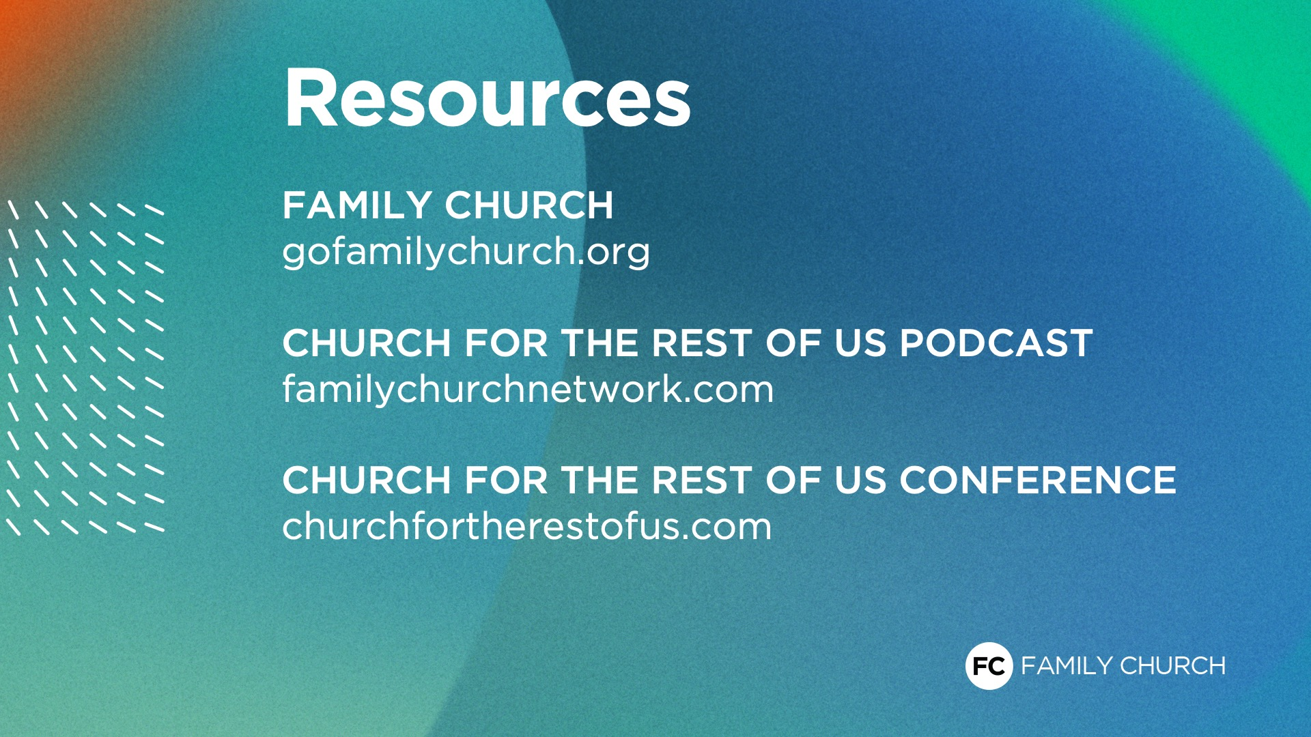

Slide 28
BUILDING AN EVANGELISTIC
CHURCH CULTURE

