Slide 1
BREAKTHROUGH: Creating a New Scorecard for
Group Ministry Success
Notes:
A new scorecard for groups = more than just “how many people were in attendance today?”
If we measured groups by other metrics, we could see where improvement is needed
Attendance is important, but it is not the only way to evaluate a group’s effectiveness
A group can be small and be great at making disciples
A group can be large, but it may not be healthy
In a post-pandemic world, groups need a new scorecard!

Slide 2
Which of these icons best represents your church’s group ministry?

Slide 3
Transformational Church Research Findings
In growing churches (churches that grew at least 5% for three consecutive years), Sunday School was “step-two” in 87.5% of them.

Slide 4
Research has proven that people who are being discipled in groups…
Give more
Serve more
Pray more
Confess sin more
Share their faith more
“Stick” more

Slide 5
Percentage of New Christians Who Remained Active 5 Years After Joining the Church

Slide 6
“The grass is always greener on the other side” is false

Slide 7
It’s greener where you water it

Slide 8
To say it another way…
Sunday School works,
but you must work
Sunday School

Slide 9
I
love
golf

Slide 10
Fairways in Regulation (FIR)

Slide 11
Greens in Regulation (GIR)

Slide 12
Number of Putts

Slide 13
In golf, there’s more than one way to measure success besides the final score.

Slide 14
In Bible study, there’s more than one way to measure ministry success than attendance

Slide 15
“We can’t measure discipleship by how many people are in small groups, or how many are in our classes…”
p.22

Slide 16
4 Essential Tasks for Groups

Slide 17
We’re really talking about “clarifying the win”
“Clarifying the win simply means communicating to your team what is really important, what really matters. The best way to leverage the collective power of your team is to make sure that everyone knows what it means to “score.”
If the win is unclear, you may force those in leadership roles to define winning in their own terms. If you don’t define winning for your ministry leaders, they will define it for themselves.”
- Seven Practices of Effective Ministry

Slide 18
Scorecard Measurement #1
Learn & Obey God’s Word

Slide 19
“Community is indispensable to discipleship, but community isn’t discipleship...it is not enough to connect people to community, it must be community that is committed to learning the way of Jesus together...”
p.83

Slide 20
LEARN AND OBEY GOD’S WORD
Chapter 1: Are group members maturing as disciples?
Notes:
Q2: Are Bible studies well-prepared and engaging?
My experience when visiting churches…not so much
Should incorporate the 8 learning approaches over time
Musical, Logical, Reflective, Relational, Natural, Physical, Visual, Verbal
Q3: Are apprentice leaders identified and developed?
New groups need needs leaders (more in a minute)…apprentices are the key
Difference between a sub and an apprentice
Q4: Are new groups started regularly?
Groups turn inward at 18-24 months
LEGO factor
New groups reach new people faster
New groups add 10 people on average

Slide 21
One word is used over and over to describe the life of discipleship in both the Old & New Testaments…
Notes:
For example, Micah 6:8 says “Mankind, he has told each of you what is good and what it is the Lord requires of you: to act justly, to love faithfulness, and to walk humbly with your God.” In the book of Ephesians, Paul used the word 6 times to describe how a Christ-follower is supposed to live with Jesus: “Walk worthy. Walk in love. Walk in good works.” Then there’s the brief account of Enoch in Genesis 5: “Enoch was 65 years old when he fathered Methuselah. And after he fathered Methuselah, Enoch walked with God 300 years and fathered other sons and daughters. So Enoch’s life lasted 365 years. Enoch walked with God; then he was not there because God took him.

Slide 22
WALK
Ephesians 5:2
Micah 6:8
Colossians 1:10
Ephesians 4:1
Genesis 5:21-24

Slide 23
8 Signposts of Discipleship

Slide 24
1. Obey God & Deny Self

Slide 25
2. Engage with Scripture

Slide 26
3. Share Christ

Slide 27
4. Exercise Faith

Slide 28
5. Seek God

Slide 29
6. Build Relationships

Slide 30
7. Live Unashamed

Slide 31
8. Serve God and Others

Slide 32
Group leaders must teach for transformation, not just a transfer of information

Slide 33
Which is easier…teaching information or for transformation?

Slide 34
LEARN AND OBEY GOD’S WORD
Chapter 1: Are group members maturing as disciples?
Chapter 2: Are Bible studies well-prepared and engaging?
Notes:
Q2: Are Bible studies well-prepared and engaging?
My experience when visiting churches…not so much
Should incorporate the 8 learning approaches over time
Musical, Logical, Reflective, Relational, Natural, Physical, Visual, Verbal
Q3: Are apprentice leaders identified and developed?
New groups need needs leaders (more in a minute)…apprentices are the key
Difference between a sub and an apprentice
Q4: Are new groups started regularly?
Groups turn inward at 18-24 months
LEGO factor
New groups reach new people faster
New groups add 10 people on average

Slide 35
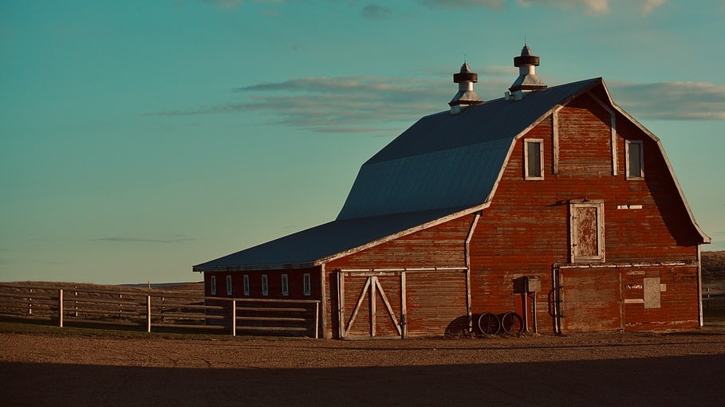
“Every Sunday School teacher wants to teach good lessons, but every Sunday School teacher is not committed to do what it takes to have good lessons. The have not put any hay in the barn during the week, so the loft is empty on Sunday morning. If you are committed to preparation, you will be a great Sunday School teacher.”
– Allan Taylor (The Six Core Values of Sunday School, p. 96)

Slide 36
Too many Saturday Night Specials?
The Lifeway website spikes every Saturday night and Sunday morning.
Last-minute preparation does not lead to excellence.

Slide 37
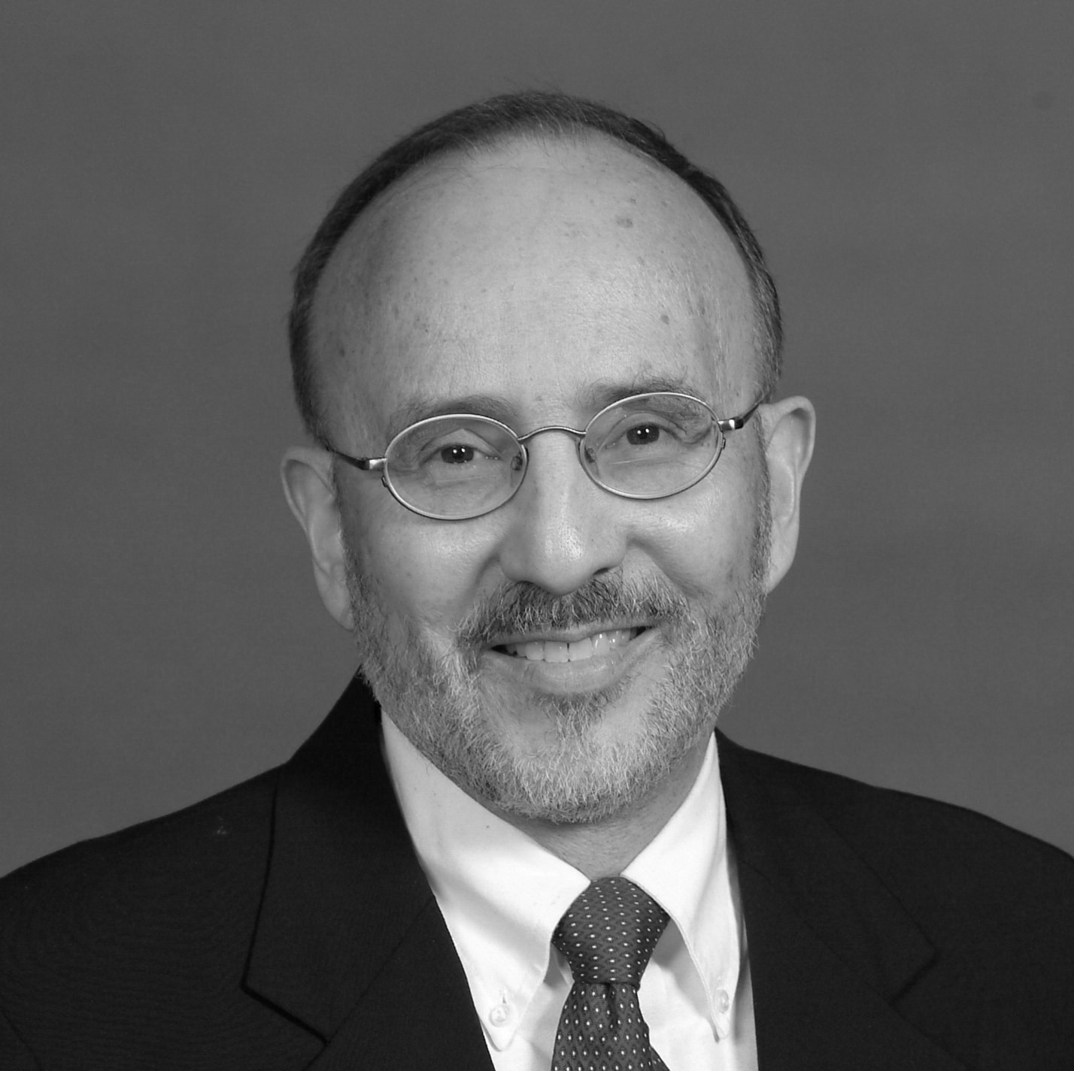
Preparation is an Act of Love
“Preparation can be viewed as an act of love and a form of worship that seeks to give glory to God.”
– Robert Pazmino

Slide 38
Preparation is an Act of Love
“Preparation can be an expression of loving care for the ministry of teaching to which one is called by God. The second of the two great commandments, loving one’s neighbor as oneself, can be associated with the care of preparation for one’s students, for the context in which the teaching is planned to occur, and for the content of the teaching itself.”

Slide 39
Robert Pazmino, Brussels Sprouts, and a Lesson Learned

Slide 40
“The will to win is not nearly so important as the will to prepare to win.” -Coach Vince Lombardi

Slide 41
See the daily preparation plan on pages 23-25

Slide 42
Preparation on the teacher’s part can lead to greater engagement on the part of the group members. Remember: “Teaching isn’t telling; learning isn’t listening”

Slide 43
“…the best way to help people change is to involve them…in the learning experience. Each lesson needs to involve people in a variety of learning activities…” (p.107)

Slide 44
No pitcher would dare throw the same pitch over and over again…

Slide 46
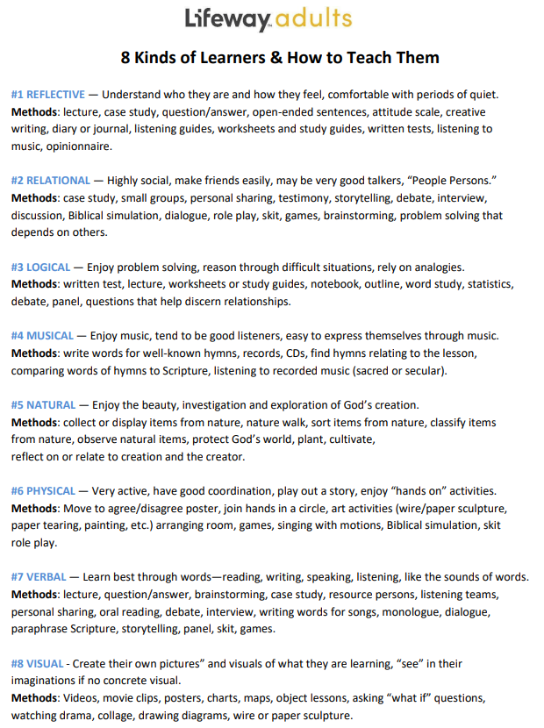

Slide 48
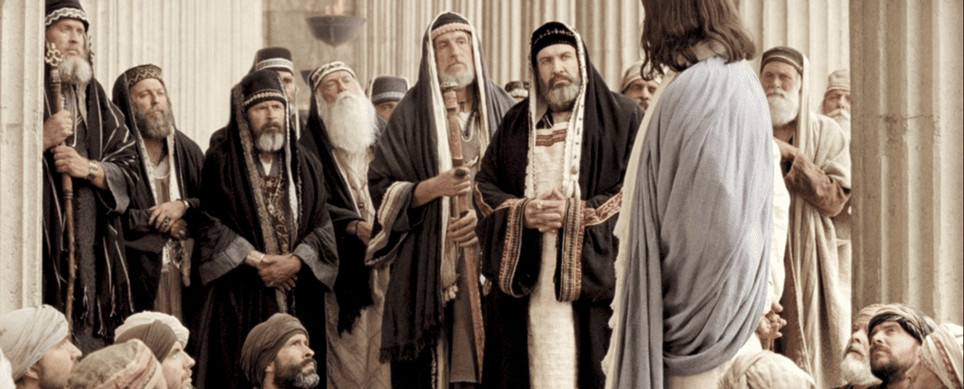
Jesus used over 22 different ways to communicate truth

Slide 49
Let’s Practice!
If our Bible study leader guide suggests we ask a question, how might we make that more engaging by turning it into a RELATIONAL activity? A VISUAL activity? A PHYSICAL activity?
If you are studying a longer passage of Scripture and it is suggested that someone in the group read the text, what might you do to make that more engaging?
Instead of just pointing to a location on a biblical map, how might we make that more engaging?

Slide 50
LEARN AND OBEY GOD’S WORD
Chapter 1: Are group members maturing as disciples?
Chapter 2: Are Bible studies well-prepared and engaging?
Chapter 3: Are apprentice leaders identified and developed?
Notes:
Q2: Are Bible studies well-prepared and engaging?
My experience when visiting churches…not so much
Should incorporate the 8 learning approaches over time
Musical, Logical, Reflective, Relational, Natural, Physical, Visual, Verbal
Q3: Are apprentice leaders identified and developed?
New groups need needs leaders (more in a minute)…apprentices are the key
Difference between a sub and an apprentice
Q4: Are new groups started regularly?
Groups turn inward at 18-24 months
LEGO factor
New groups reach new people faster
New groups add 10 people on average

Slide 51
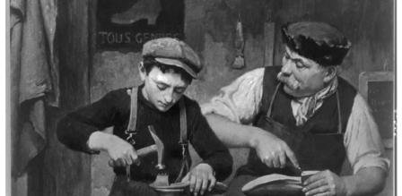
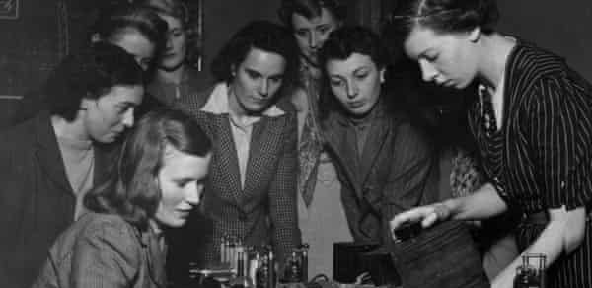
Apprenticeship has a long history dating back to the earliest times in Egypt and Babylon. Apprentices were developed so that skills could be passed down from craftsman to craftsman, ensuring that there were always enough artisans to serve the needs of society.

Slide 52
Did You know Elvis was an apprentice electrician?

Slide 53
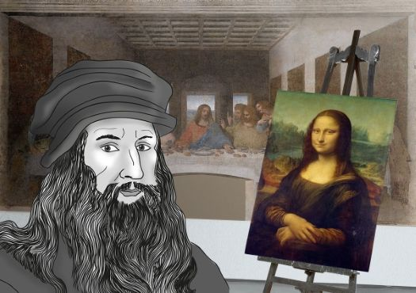
Leonardo Di Vinci started out as an apprentice painter

Slide 54
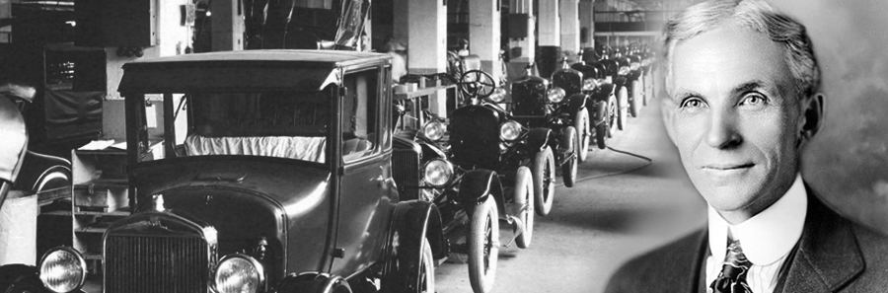
Henry Ford apprenticed as a machinist

Slide 55
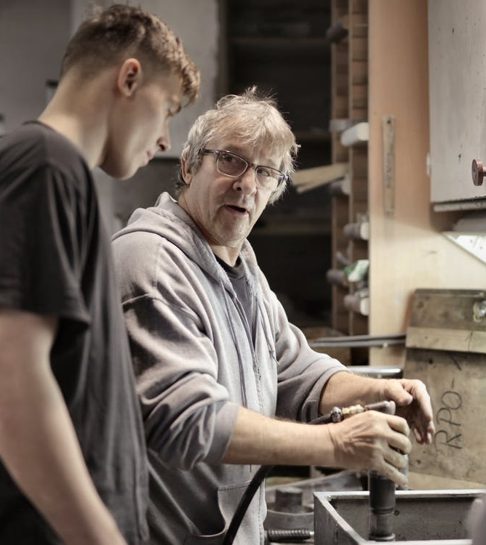
Apprentice leaders are the future of your church’s Bible study ministry

Slide 56
What kinds of things would an apprentice need to know to be effective as a group leader?

Slide 57
Every group needs an apprentice teacher
Group leaders help by “enlisting a true apprentice…who buys into the great expectation of planting a new class.”
– Great Expectations, 43

Slide 58
Apprentice leaders help the church in 4 important ways…
They keep the group focused outwardly
They prevent leadership voids
They reach new people by starting new groups
They prevent the idea of “permanence” from taking hold

Slide 59
What is your reaction to points 1 and 2 on pages 49-51 of Breakthrough regarding Moses and his succession plan?

Slide 60
Pages 52-60 -Selecting an apprentice -5 steps for developing an apprentice -A 6 month plan for developing an apprentice -6 things every apprentice needs

Slide 61
LEARN AND OBEY GOD’S WORD
Chapter 1: Are group members maturing as disciples?
Chapter 2: Are Bible studies well-prepared and engaging?
Chapter 3: Are apprentice leaders identified and developed?
Chapter 4: Are new groups started regularly?
Notes:
Q2: Are Bible studies well-prepared and engaging?
My experience when visiting churches…not so much
Should incorporate the 8 learning approaches over time
Musical, Logical, Reflective, Relational, Natural, Physical, Visual, Verbal
Q3: Are apprentice leaders identified and developed?
New groups need needs leaders (more in a minute)…apprentices are the key
Difference between a sub and an apprentice
Q4: Are new groups started regularly?
Groups turn inward at 18-24 months
LEGO factor
New groups reach new people faster
New groups add 10 people on average

Slide 63
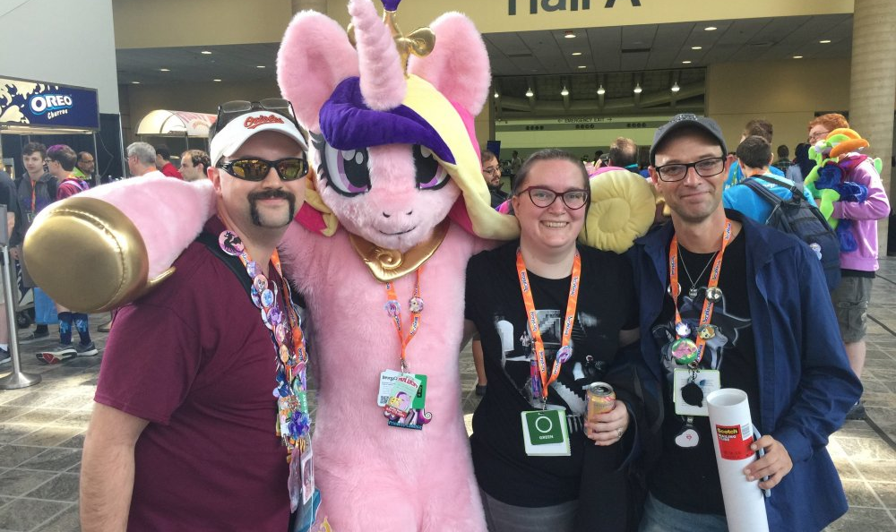
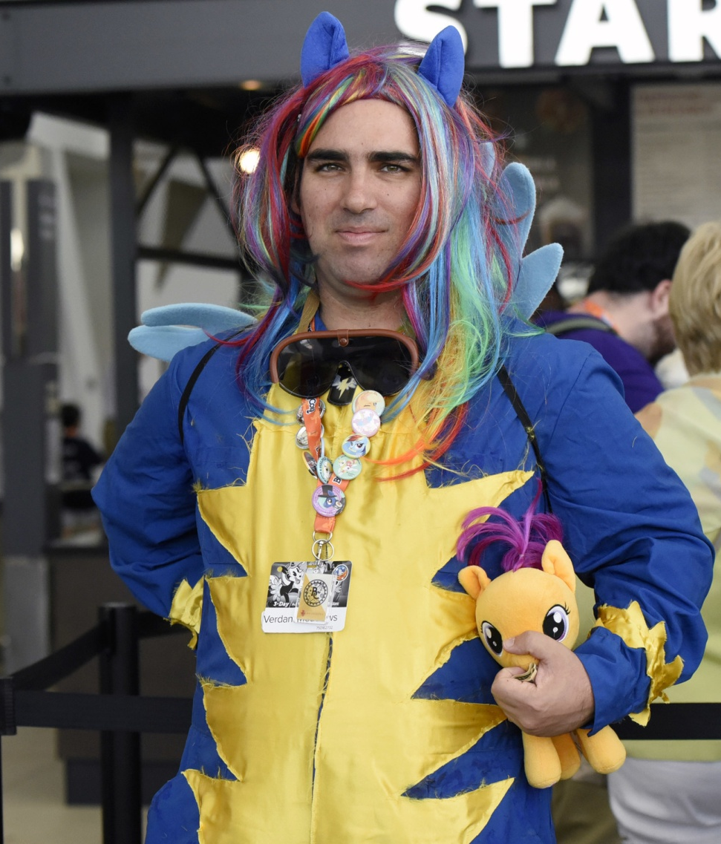
Bronycon

Slide 65
We have a God-given need for others

Slide 66
“We want you to birth a new class”
“Let’s split your group”
“Can we divide your class?”

Slide 68
New groups:
Add 10 people on average
Raise your annual giving by $11-13K (or more)
Grow faster than older established groups
Are more outwardly focused & evangelistic
Overcome the “LEGO” factor…

Slide 69
New Groups Overcome
the “LEGO” Factor

Slide 70
Discuss one of these at your table:
Which two of the 8 signposts are most noticeable in your groups? Which are most lacking?
Are your groups’ Bible studies well-prepared, engaging, or both? Why do you believe that?
What would it take for every group in your church to develop one apprentice over the next 12 months?
How can you elevate the awareness of the need for new groups? What’s the biggest factor keeping new groups from being started?

Slide 71
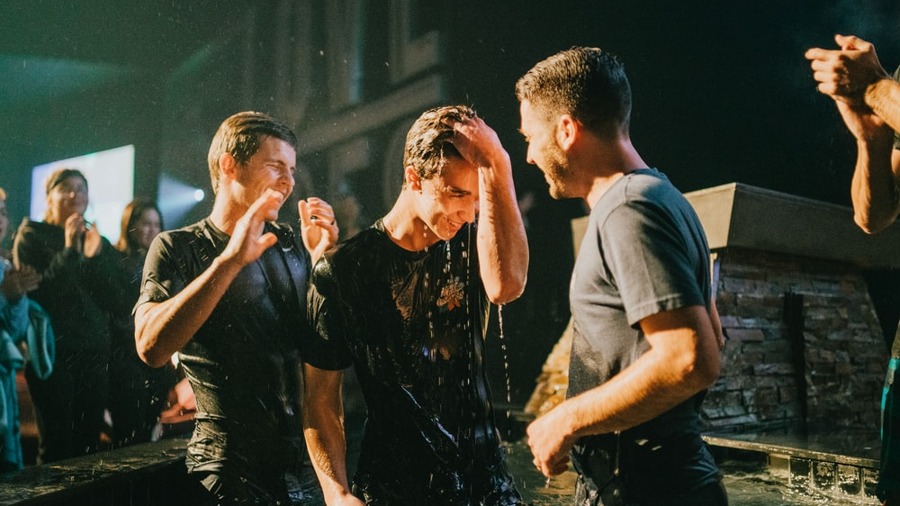
Invite People to Become Disciples
Measurement #2
Notes:
This is the evangelism part of group life
Our groups should exist to make disciples

Slide 72
INVITE PEOPLE TO BECOME DISCIPLES
Chapter 5: Are prayers focused on the lost?
Notes:
Q1: Are prayers focused on the lost?
Connect 3 book by David Francis
3 stages of group life
Class stage (praying for stubbed toes)
Community stage (praying for each other)
Commission stage (praying for lost friends and family)
Q2: Are group members eating with sinners and tax collectors?
Jesus did!
The longer we are in church, the less lost people we know
Must create margin on our personal calendars for relating to people who are lost
Goal is to build relationships and “win a hearing”
Don’t want to make people feel like they are a “project”
Q3: Are new persons invited to connect with the group?
47% of people who attend a group do so because a group member or the leader invited them!
Inviting people to be disciples sometimes starts with an invitation to a party or other event
Juan Ortiz: “People opposed to the gopel aren’t opposed to ice cream”
Q4: Are group members initiating gospel conversations?
People need to know 2 things:
How to share their story (testimony)
A simple gospel presentation (I like the Navigators’ “1 verse evangelism” method

Slide 73
3 Kinds of Prayers in Groups
“Class” Level
“Community” Level
“Commission” Level

Slide 74
“Each teacher should have a prayer list both of the lost pupils in his class and of the lost who are prospects for his class. This list should be kept in the Bible and daily spread out before God as the teacher prays for each one by name… Many Sunday School pupils can be reached only through prayer.” – Building a Standard Sunday School, p.103

Slide 75
“The supreme business of Christianity is to win the lost to Christ. This is what churches are for. It was Christ’s supreme mission…surely then the Sunday School must relate itself to the winning of the lost to Christ as an ultimate objective”
- Arthur Flake

Slide 76
Identify 1 lost person you know. Write their name on your listening guide.
Share their name and your relationship to them with the people at your table.
Let’s pray for them before we proceed.

Slide 77
INVITE PEOPLE TO BECOME DISCIPLES
Chapter 5: Are prayers focused on the lost?
Chapter 6: Are group members eating with “sinners & tax collectors?
Notes:
Q1: Are prayers focused on the lost?
Connect 3 book by David Francis
3 stages of group life
Class stage (praying for stubbed toes)
Community stage (praying for each other)
Commission stage (praying for lost friends and family)
Q2: Are group members eating with sinners and tax collectors?
Jesus did!
The longer we are in church, the less lost people we know
Must create margin on our personal calendars for relating to people who are lost
Goal is to build relationships and “win a hearing”
Don’t want to make people feel like they are a “project”
Q3: Are new persons invited to connect with the group?
47% of people who attend a group do so because a group member or the leader invited them!
Inviting people to be disciples sometimes starts with an invitation to a party or other event
Juan Ortiz: “People opposed to the gopel aren’t opposed to ice cream”
Q4: Are group members initiating gospel conversations?
People need to know 2 things:
How to share their story (testimony)
A simple gospel presentation (I like the Navigators’ “1 verse evangelism” method

Slide 78
Matthew 9:10-13
While Jesus was having dinner at Matthew’s house, many tax collectors and sinners came and ate with him and his disciples. When the Pharisees saw this, they asked his disciples, “Why does your teacher eat with tax collectors and sinners?” On hearing this, Jesus said, “It is not the healthy who need a doctor, but the sick…For I have not come to call the righteous, but sinners.”

Slide 79
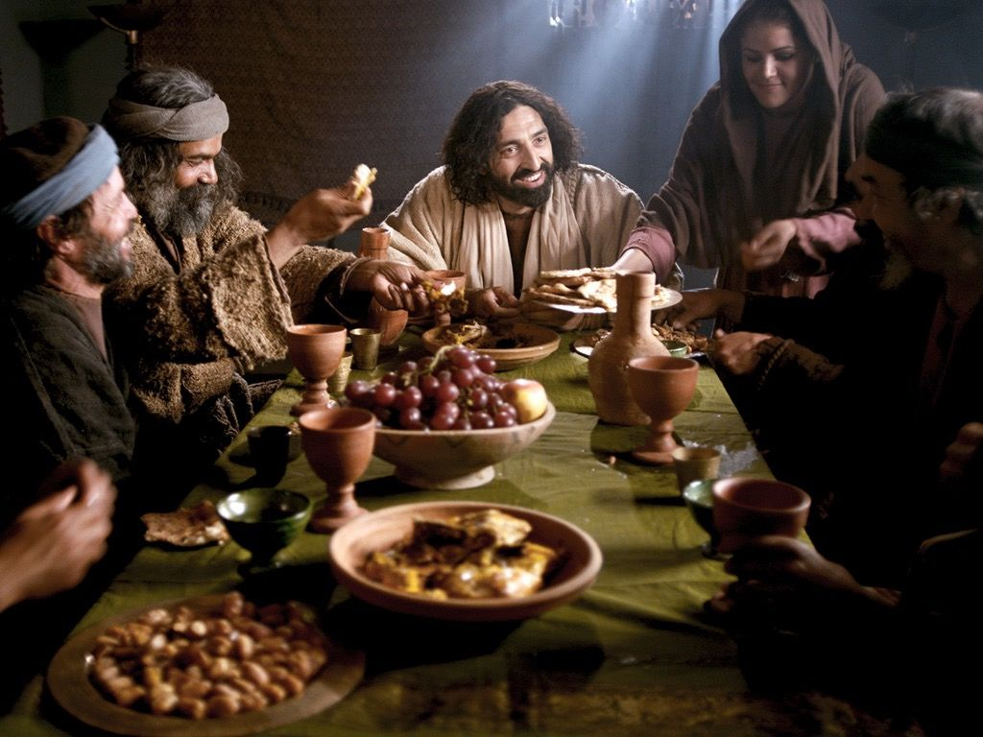
Kingdom Pastor – Wordress.com

Slide 80
INVITE PEOPLE TO BECOME DISCIPLES
Chapter 5: Are prayers focused on the lost?
Chapter 6: Are group members eating with “sinners & tax collectors?
Chapter 7: Are new persons invited to connect with the group?
Notes:
Q1: Are prayers focused on the lost?
Connect 3 book by David Francis
3 stages of group life
Class stage (praying for stubbed toes)
Community stage (praying for each other)
Commission stage (praying for lost friends and family)
Q2: Are group members eating with sinners and tax collectors?
Jesus did!
The longer we are in church, the less lost people we know
Must create margin on our personal calendars for relating to people who are lost
Goal is to build relationships and “win a hearing”
Don’t want to make people feel like they are a “project”
Q3: Are new persons invited to connect with the group?
47% of people who attend a group do so because a group member or the leader invited them!
Inviting people to be disciples sometimes starts with an invitation to a party or other event
Juan Ortiz: “People opposed to the gopel aren’t opposed to ice cream”
Q4: Are group members initiating gospel conversations?
People need to know 2 things:
How to share their story (testimony)
A simple gospel presentation (I like the Navigators’ “1 verse evangelism” method

Slide 81
Assimilation is accelerated by invitation

Slide 82
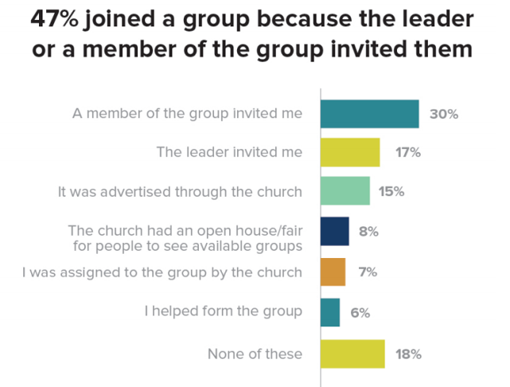

Slide 83
Maybe our groups have asked the wrong question for years…
“Would you fill this out?” should give way to a better question:
“May I enroll you in our group?”

Slide 84
Don’t be shy about “asking for the sale”

Slide 85
INVITE PEOPLE TO BECOME DISCIPLES
Chapter 5: Are prayers focused on the lost?
Chapter 6: Are group members eating with “sinners & tax collectors?
Chapter 7: Are new persons invited to connect with the group?
Chapter 8: Are group members initiating gospel conversations?
Notes:
Q1: Are prayers focused on the lost?
Connect 3 book by David Francis
3 stages of group life
Class stage (praying for stubbed toes)
Community stage (praying for each other)
Commission stage (praying for lost friends and family)
Q2: Are group members eating with sinners and tax collectors?
Jesus did!
The longer we are in church, the less lost people we know
Must create margin on our personal calendars for relating to people who are lost
Goal is to build relationships and “win a hearing”
Don’t want to make people feel like they are a “project”
Q3: Are new persons invited to connect with the group?
47% of people who attend a group do so because a group member or the leader invited them!
Inviting people to be disciples sometimes starts with an invitation to a party or other event
Juan Ortiz: “People opposed to the gopel aren’t opposed to ice cream”
Q4: Are group members initiating gospel conversations?
People need to know 2 things:
How to share their story (testimony)
A simple gospel presentation (I like the Navigators’ “1 verse evangelism” method

Slide 86
Talk about a great exchange…
Kyle McDonald & his One Red Paperclip Experiment
Notes:
On July 14, 2005, he went to Vancouver and traded the paperclip for a fish-shaped pen.He then traded the pen the same day for a hand-sculpted doorknob from Seattle, Washington.On July 25, 2005, he travelled to Amherst, Massachusetts, with a friend to trade the doorknob for a Coleman camp stove (with fuel).On September 24, 2005, he went to California, and traded the camp stove for a Honda generator.On November 16, 2005, he traveled to Maspeth, Queens and traded the generator for an "instant party": an empty keg, an IOU for filling the keg with the beer of the bearer's choice, and a neon Budweiser sign. This was his second attempt to make the trade; his first resulted in the generator being temporarily confiscated by the New York City Fire Department.On December 8, 2005, he traded the "instant party" to Quebec comedian and radio personality Michel Barrette for a Ski-Doo snowmobile.Within a week of that, he traded the snowmobile for a two-person trip to Yahk, British Columbia, scheduled for February 2006.On or about January 7, 2006, he traded the second spot on the Yahk trip for a box truck.On or about February 22, 2006, he traded the box truck for a recording contract with Metalworks in Mississauga, Ontario.On or about April 11, 2006, he traded the contract to Jody Gnant for a year's rent in Phoenix, Arizona.On or about April 26, 2006, he traded the year's rent in Phoenix for one afternoon with Alice Cooper.On or about May 26, 2006, he traded the afternoon with Cooper for a KISS motorized snow globe.On or about June 2, 2006, he traded the snow globe to Corbin Bernsen for a role in the film Donna on Demand.^{[3]}On or about July 5, 2006, he traded the movie role for a two-story farmhouse in Kipling, Saskatchewan.

Slide 93
2-person trip to yahk, British columbia

Slide 94
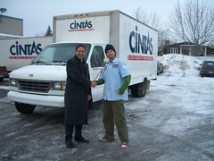
Kyle exchanged the second spot on the yahk, British Columbia trip for this box truck

Slide 95
Kyle exchanged the box truck for a recording contract with Metalworks

Slide 96
Kyle exchanged the recording contract for one year’s rent in phoenix, AZ

Slide 97
Kyle Exchanged one year’s rent for an afternoon with…

Slide 98
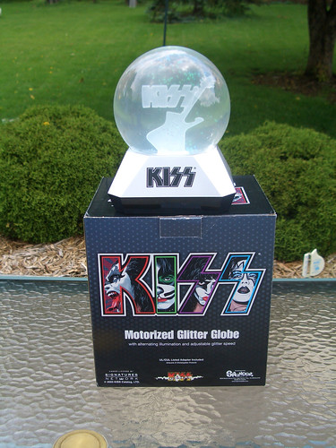
Kyle exchanged the afternoon with Alice Cooper for a motorized “kiss” snow globe

Slide 99
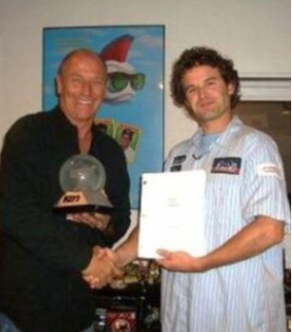
Kyle exchanged the KISS snow globe to actor/director Corbin Bernsen for a paid role in his movie Debbie on Demand

Slide 100
And finally, on his last (and 14th trade), Kyle McDonald exchanged the movie role to the city of Kipling, Saskatchewan, for…

Slide 104
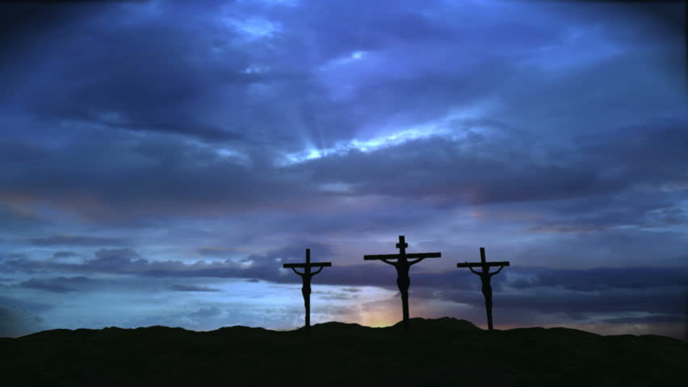
THE GREATEST EXCHANGE IN HISTORY…
2 Corinthians 5:21
Notes:
On July 14, 2005, he went to Vancouver and traded the paperclip for a fish-shaped pen.He then traded the pen the same day for a hand-sculpted doorknob from Seattle, Washington.On July 25, 2005, he travelled to Amherst, Massachusetts, with a friend to trade the doorknob for a Coleman camp stove (with fuel).On September 24, 2005, he went to California, and traded the camp stove for a Honda generator.On November 16, 2005, he traveled to Maspeth, Queens and traded the generator for an "instant party": an empty keg, an IOU for filling the keg with the beer of the bearer's choice, and a neon Budweiser sign. This was his second attempt to make the trade; his first resulted in the generator being temporarily confiscated by the New York City Fire Department.On December 8, 2005, he traded the "instant party" to Quebec comedian and radio personality Michel Barrette for a Ski-Doo snowmobile.Within a week of that, he traded the snowmobile for a two-person trip to Yahk, British Columbia, scheduled for February 2006.On or about January 7, 2006, he traded the second spot on the Yahk trip for a box truck.On or about February 22, 2006, he traded the box truck for a recording contract with Metalworks in Mississauga, Ontario.On or about April 11, 2006, he traded the contract to Jody Gnant for a year's rent in Phoenix, Arizona.On or about April 26, 2006, he traded the year's rent in Phoenix for one afternoon with Alice Cooper.On or about May 26, 2006, he traded the afternoon with Cooper for a KISS motorized snow globe.On or about June 2, 2006, he traded the snow globe to Corbin Bernsen for a role in the film Donna on Demand.^{[3]}On or about July 5, 2006, he traded the movie role for a two-story farmhouse in Kipling, Saskatchewan.

Slide 105
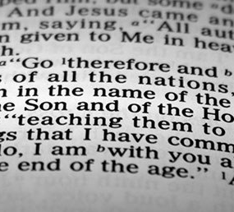
The purpose of groups is to make disciples…
Which includes evangelism plus teaching

Slide 106
Discipleship & evangelism are like the two wings on a plane – both are essential

Slide 107
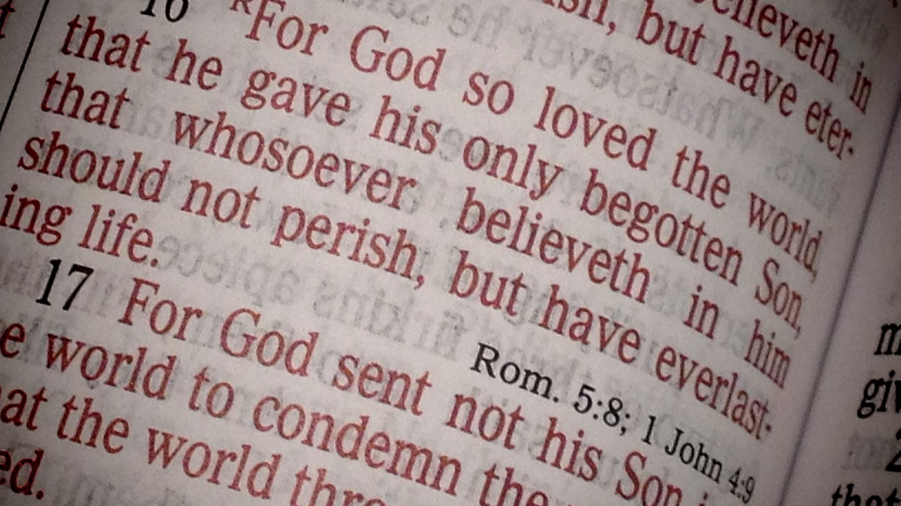
In my experience as a group leader, my people began sharing the gospel when I taught them how to do 2 things:

Slide 108
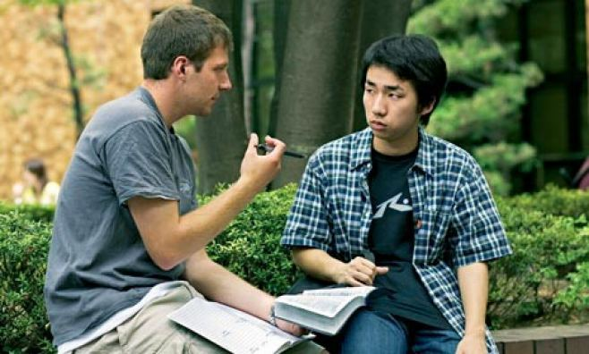
1. HOW TO SHARE THEIR TESTIMONY (STORY)
Life before Christ
How you accepted Christ
Life after deciding to follow Christ

Slide 109
When meeting someone new, 71% of Americans are at least open to hearing about that person’s life story. A similar number (69%) say they’re at least open to hearing the life story from someone new if it includes faith. – Lifeway Research, 2/22/22

Slide 110
2. HOW TO SHARE THE GOSPEL SIMPLY

Slide 111
For the wages of sin is death, but the gift of God is eternal life in Jesus Christ our Lord Romans 6:23

Slide 112
Discuss one of these at your table:
How could you teach your congregation a simple way to share the gospel?
How can you lead your groups to pray for lost persons more regularly?
What options do you see for creating a “culture of invitation” within your church?
How can group members be encouraged to “eat with sinners and tax collectors” to build bridges that lead to gospel conversations?

Slide 113
Measurement #3 Form Deeper Relationships

Slide 114
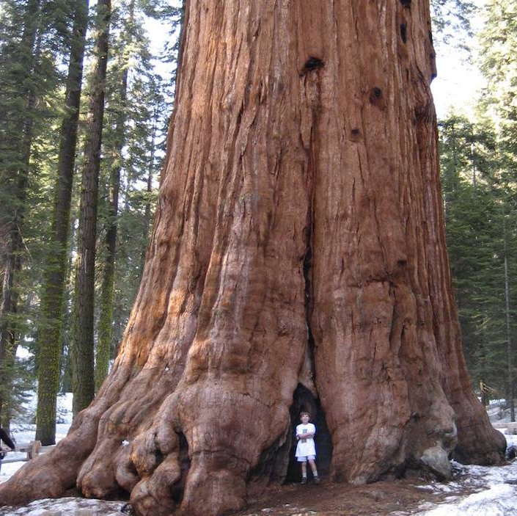
The Sequoia Tree
Notes:
To emphasize the need to live in close proximity to other disciples for the purpose of maturing in our relationship with Christ, explain the secrets of the Sequoia tree.
The secret of these massive trees is that although their root systems are only 4-5 feet deep, they intertwine with the trees next to them. This allows them to stand tall when winds and storms threaten them.
Say, “In a similar way, people in our churches need relationships with other believers. It is important, therefore, to make sure we have a groups structure into which we can direct these people.”

Slide 115
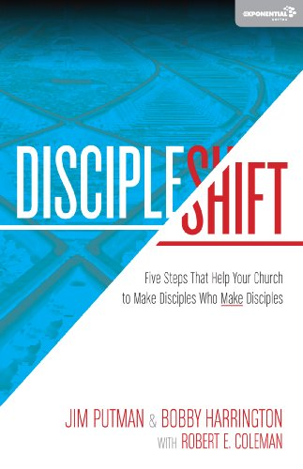
“…Jesus invited people into relationships with himself…His primary method was life-on-life.” –p.33
Notes:
As participants view this slide, Ask them, “If this is true, what does this say about the importance of our church’s teaching/disciple-making ministries? What might need to change in order for us to more closely follow the biblical pattern?” (List responses on a marker board).

Slide 116
FORM DEEPER RELATIONSHIPS
Chapter 9: Is the group organized to care for people?
Notes:
Q1: Is the group organized to care?
Teachers can’t do everything, nor should they
Exodus 18 – Moses & Jethro’s talk/Acts 6 – widows, food, and the disciples
Care groups!
Q2: Are connection and content balanced?
SS is more than just Bible study
Groups need regular times for fellowship and fun outside of Bible study
Balance is key…too much to one side or the other is not healthy
Q3: Does the group effectively assimilate new people?
You can be a member of a group and never be a part of the group
Assimilate = “make similar, absorb into a group or culture”
Q4: Are micro-groups used to make and multiply disciples?
3-4 people max / same sex
Higher level of intimacy and accountability
Lifeway ongoing studies have this feature!

Slide 117
“One of the things that sets apart a healthy Sunday School or small group ministry from a struggling one is a commitment to care for every person.”
Shepherd: Creating Caring Community, p 7

Slide 118
The Key Transition: From Class Role to Ministry List
“Perhaps the first step a group must take to signal that it wants to create caring community is to change what it calls the roster of people who are members of the group. If it’s just a Bible study group that meets once a week, the people who have enrolled are put on a Class Roll…
Shepherd: Creating a Caring Community, p. 8

Slide 119
The Key Transition: From Class Role to Ministry List
…In a caring community, they are added to a Ministry List. What’s the difference? A Class Roll connotes that the primary commitment is from Member to Class. That is, the member has made a commitment to attend the class. A Ministry List, on the other hand, connotes that the primary commitment is from Class/Community to the Member.”
Shepherd: Creating a Caring Community, p. 8

Slide 120
The Key?
Organize and contact every member every week

Slide 121
FORM DEEPER RELATIONSHIPS
Chapter 9: Is the group organized to care for people?
Chapter 10: How balanced are connection and content?
Notes:
Q1: Is the group organized to care?
Teachers can’t do everything, nor should they
Exodus 18 – Moses & Jethro’s talk/Acts 6 – widows, food, and the disciples
Care groups!
Q2: Are connection and content balanced?
SS is more than just Bible study
Groups need regular times for fellowship and fun outside of Bible study
Balance is key…too much to one side or the other is not healthy
Q3: Does the group effectively assimilate new people?
You can be a member of a group and never be a part of the group
Assimilate = “make similar, absorb into a group or culture”
Q4: Are micro-groups used to make and multiply disciples?
3-4 people max / same sex
Higher level of intimacy and accountability
Lifeway ongoing studies have this feature!

Slide 122
CONNECTION
CONTENT

Slide 123
“Growing churches…will realize that connection and community will win out over content in the end…”
- Carey Nieuwhof

Slide 124
We all need “2 AM” friends
Notes:
Carey Nieuwhoff’s blog post “8 Disruptive Church Trends that will Rule 2021”
#5 was “Content alone won’t cut it. Community and connection will”

Slide 125
FORM DEEPER RELATIONSHIPS
Chapter 9: Is the group organized to care for people?
Chapter 10: How balanced are connection and content?
Chapter 11: Do newcomers experience biblical hospitality?
Notes:
Q1: Is the group organized to care?
Teachers can’t do everything, nor should they
Exodus 18 – Moses & Jethro’s talk/Acts 6 – widows, food, and the disciples
Care groups!
Q2: Are connection and content balanced?
SS is more than just Bible study
Groups need regular times for fellowship and fun outside of Bible study
Balance is key…too much to one side or the other is not healthy
Q3: Does the group effectively assimilate new people?
You can be a member of a group and never be a part of the group
Assimilate = “make similar, absorb into a group or culture”
Q4: Are micro-groups used to make and multiply disciples?
3-4 people max / same sex
Higher level of intimacy and accountability
Lifeway ongoing studies have this feature!

Slide 126
What is Biblical Hospitality?
Treating strangers like they are friends

Slide 127
6 Ways to Show Hospitality in Groups
Enlist a group host/hostess
Invite guests to lunch
Invite guests to all fellowships/fun activities
Have extra chairs
Provide guests a Personal Study Guide
Wear nametags every Sunday

Slide 128
This kind is just fine…quick, easy, and inexpensive

Slide 129
FORM DEEPER RELATIONSHIPS
Chapter 9: Is the group organized to care for people?
Chapter 10: How balanced are connection and content?
Chapter 11: Do newcomers experience biblical hospitality?
Chapter 12: Are micro-groups strengthening relationships?
Notes:
Q1: Is the group organized to care?
Teachers can’t do everything, nor should they
Exodus 18 – Moses & Jethro’s talk/Acts 6 – widows, food, and the disciples
Care groups!
Q2: Are connection and content balanced?
SS is more than just Bible study
Groups need regular times for fellowship and fun outside of Bible study
Balance is key…too much to one side or the other is not healthy
Q3: Does the group effectively assimilate new people?
You can be a member of a group and never be a part of the group
Assimilate = “make similar, absorb into a group or culture”
Q4: Are micro-groups used to make and multiply disciples?
3-4 people max / same sex
Higher level of intimacy and accountability
Lifeway ongoing studies have this feature!

Slide 130
Deeper level of relationship Imitation-based discipleship

Slide 131
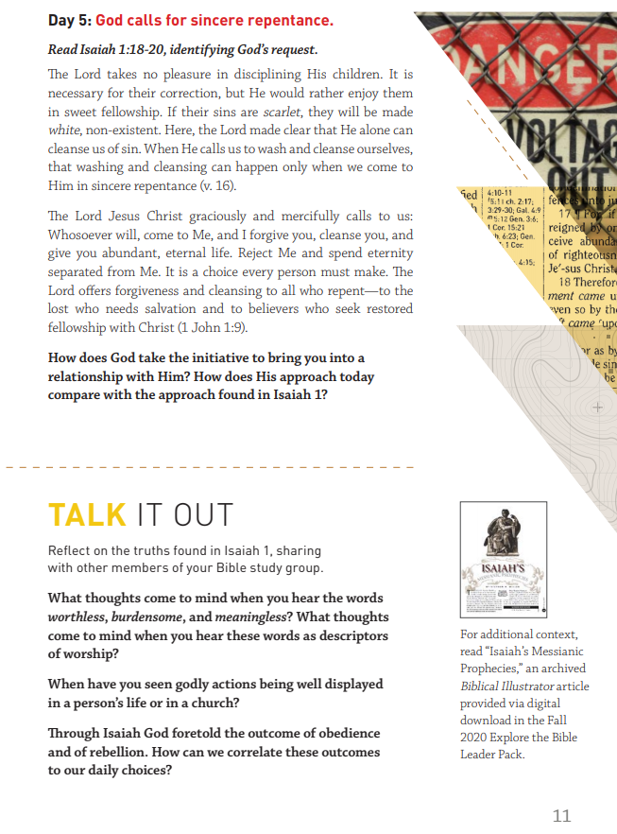
All of Lifeway’s Daily Discipleship Guides have a “micro-group” feature

Slide 132
ENGAGE IN ACTS OF SERVICE
New Scorecard Measurement 4:
Notes:
Q2: Are Bible studies well-prepared and engaging?
My experience when visiting churches…not so much
Should incorporate the 8 learning approaches over time
Musical, Logical, Reflective, Relational, Natural, Physical, Visual, Verbal
Q3: Are apprentice leaders identified and developed?
New groups need needs leaders (more in a minute)…apprentices are the key
Difference between a sub and an apprentice
Q4: Are new groups started regularly?
Groups turn inward at 18-24 months
LEGO factor
New groups reach new people faster
New groups add 10 people on average

Slide 133
ENGAGE IN ACTS OF SERVICE
Chapter 13: Is the group making a difference in the community?
Notes:
Q1: Is the group making a difference in the community?
Story of Steve and Jackie Humphrey
Q2: Are group members encouraged to serve in the church?
“SS is a clearing house, not a storehouse” – Daryl Eldridge, Rockbridge Seminary
“Catch and release” mentality
Kids and student leaders come out of adult groups!
Q3: Do people serve on the group’s leadership team?
3 Roles for Guiding Groups: Teacher/Shepherd/Leader
One person usually does not have abilities for all roles!
Positions:
Teacher. Director, Outreach, Prayer, Fellowship, Service/ministry, Admin.
Q4: Does the group support and pray for the pastor and staff?
2021 is going to be the year of turnover (William Vanderbloemen/Vanderbloemen Search Group)…”a storm surge of pastoral transitions”
Dr. Thom Rainer: “The vast majority of pastors are saying they are considering quitting their churches. It’s a trend I’ve not seen in my lifetime”

Slide 134
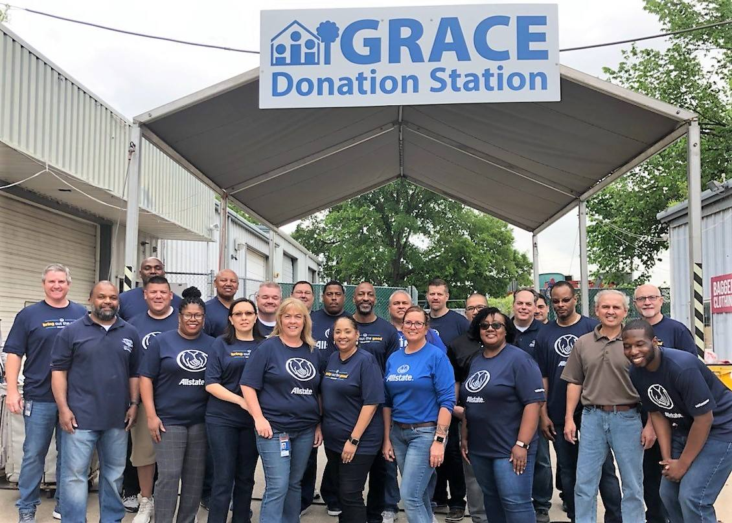

Slide 135
ENGAGE IN ACTS OF SERVICE
Chapter 13: Is the group making a difference in the community?
Chapter 14: Are group members encouraged to serve in the church?
Notes:
Q1: Is the group making a difference in the community?
Story of Steve and Jackie Humphrey
Q2: Are group members encouraged to serve in the church?
“SS is a clearing house, not a storehouse” – Daryl Eldridge, Rockbridge Seminary
“Catch and release” mentality
Kids and student leaders come out of adult groups!
Q3: Do people serve on the group’s leadership team?
3 Roles for Guiding Groups: Teacher/Shepherd/Leader
One person usually does not have abilities for all roles!
Positions:
Teacher. Director, Outreach, Prayer, Fellowship, Service/ministry, Admin.
Q4: Does the group support and pray for the pastor and staff?
2021 is going to be the year of turnover (William Vanderbloemen/Vanderbloemen Search Group)…”a storm surge of pastoral transitions”
Dr. Thom Rainer: “The vast majority of pastors are saying they are considering quitting their churches. It’s a trend I’ve not seen in my lifetime”

Slide 136
“The adult Sunday School is not a storehouse,
it is a clearing house.”

Slide 137
The primary source of volunteers for the church are adult Bible study groups
Adult group leaders must “realize and release”

Slide 138
Amos 3:12 – “The Lord says: As the shepherd snatches two legs or a piece of an ear from the lion’s mouth, so the Israelites who live in Samaria will be rescued with only the corner of a bed or the cushion of a couch”

Slide 139
ENGAGE IN ACTS OF SERVICE
Chapter 13: Is the group making a difference in the community?
Chapter 14: Are group members encouraged to serve in the church?
Chapter 15: Do people serve on the group’s leadership team?
Notes:
Q1: Is the group making a difference in the community?
Story of Steve and Jackie Humphrey
Q2: Are group members encouraged to serve in the church?
“SS is a clearing house, not a storehouse” – Daryl Eldridge, Rockbridge Seminary
“Catch and release” mentality
Kids and student leaders come out of adult groups!
Q3: Do people serve on the group’s leadership team?
3 Roles for Guiding Groups: Teacher/Shepherd/Leader
One person usually does not have abilities for all roles!
Positions:
Teacher. Director, Outreach, Prayer, Fellowship, Service/ministry, Admin.
Q4: Does the group support and pray for the pastor and staff?
2021 is going to be the year of turnover (William Vanderbloemen/Vanderbloemen Search Group)…”a storm surge of pastoral transitions”
Dr. Thom Rainer: “The vast majority of pastors are saying they are considering quitting their churches. It’s a trend I’ve not seen in my lifetime”

Slide 140
Class leadership roles
Teacher
Director
Greeter(s)
Prayer leader

Slide 141
Class leadership roles
Fellowship leader
Ministry leader
Outreach leader
Care group leader(s)

Slide 142
ENGAGE IN ACTS OF SERVICE
Chapter 13: Is the group making a difference in the community?
Chapter 14: Are group members encouraged to serve in the church?
Chapter 15: Do people serve on the group’s leadership team?
Chapter 16: Does the encourage and pray for the pastor and staff?
Notes:
Q1: Is the group making a difference in the community?
Story of Steve and Jackie Humphrey
Q2: Are group members encouraged to serve in the church?
“SS is a clearing house, not a storehouse” – Daryl Eldridge, Rockbridge Seminary
“Catch and release” mentality
Kids and student leaders come out of adult groups!
Q3: Do people serve on the group’s leadership team?
3 Roles for Guiding Groups: Teacher/Shepherd/Leader
One person usually does not have abilities for all roles!
Positions:
Teacher. Director, Outreach, Prayer, Fellowship, Service/ministry, Admin.
Q4: Does the group support and pray for the pastor and staff?
2021 is going to be the year of turnover (William Vanderbloemen/Vanderbloemen Search Group)…”a storm surge of pastoral transitions”
Dr. Thom Rainer: “The vast majority of pastors are saying they are considering quitting their churches. It’s a trend I’ve not seen in my lifetime”

Slide 143
Our pastors and staff leaders need our ongoing prayers and support

Slide 144
Learn & obey God’s Word Invite others to become disciples Form deeper relationships Engage in acts of service

Slide 145
In a post-COVID world, group ministry must be more than 9AM to noon on Sundays

Slide 147
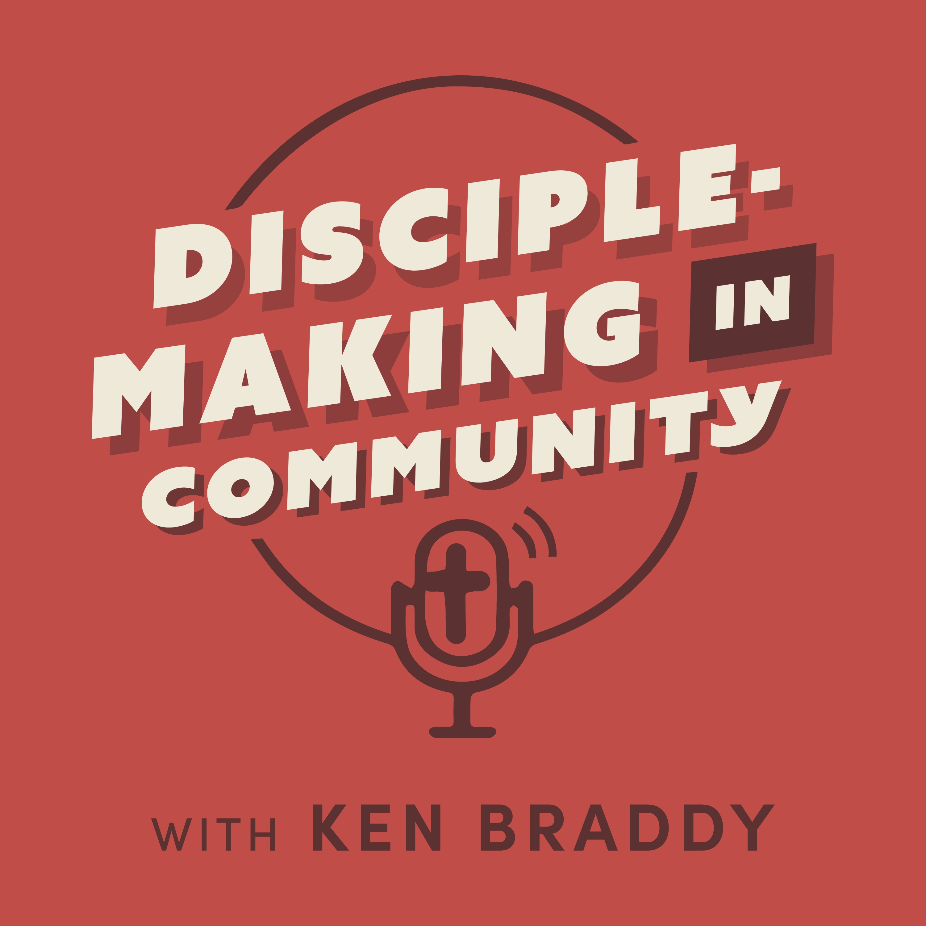
lifeway.com/dmcpodcast

Slide 148
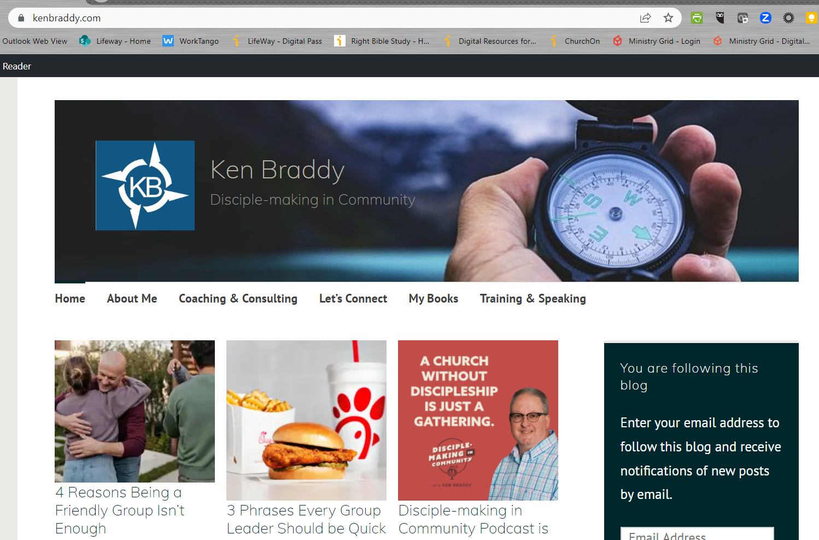
kenbraddy.com

