Slide 2
Relativity Albert Einstein, 1905

Slide 3
H2⁰

Slide 4
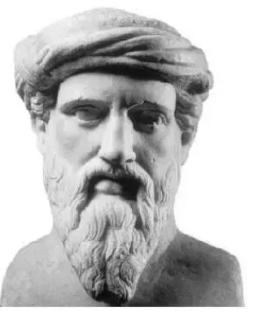
a² + b² = c²
Pythagorean Theorem

Slide 5
^{11 herbs and spices}

Slide 6
Discovering Arthur Flake’s 5-Step Formula for Growing the Sunday School

Slide 7
FBC Winona, MS

Slide 8
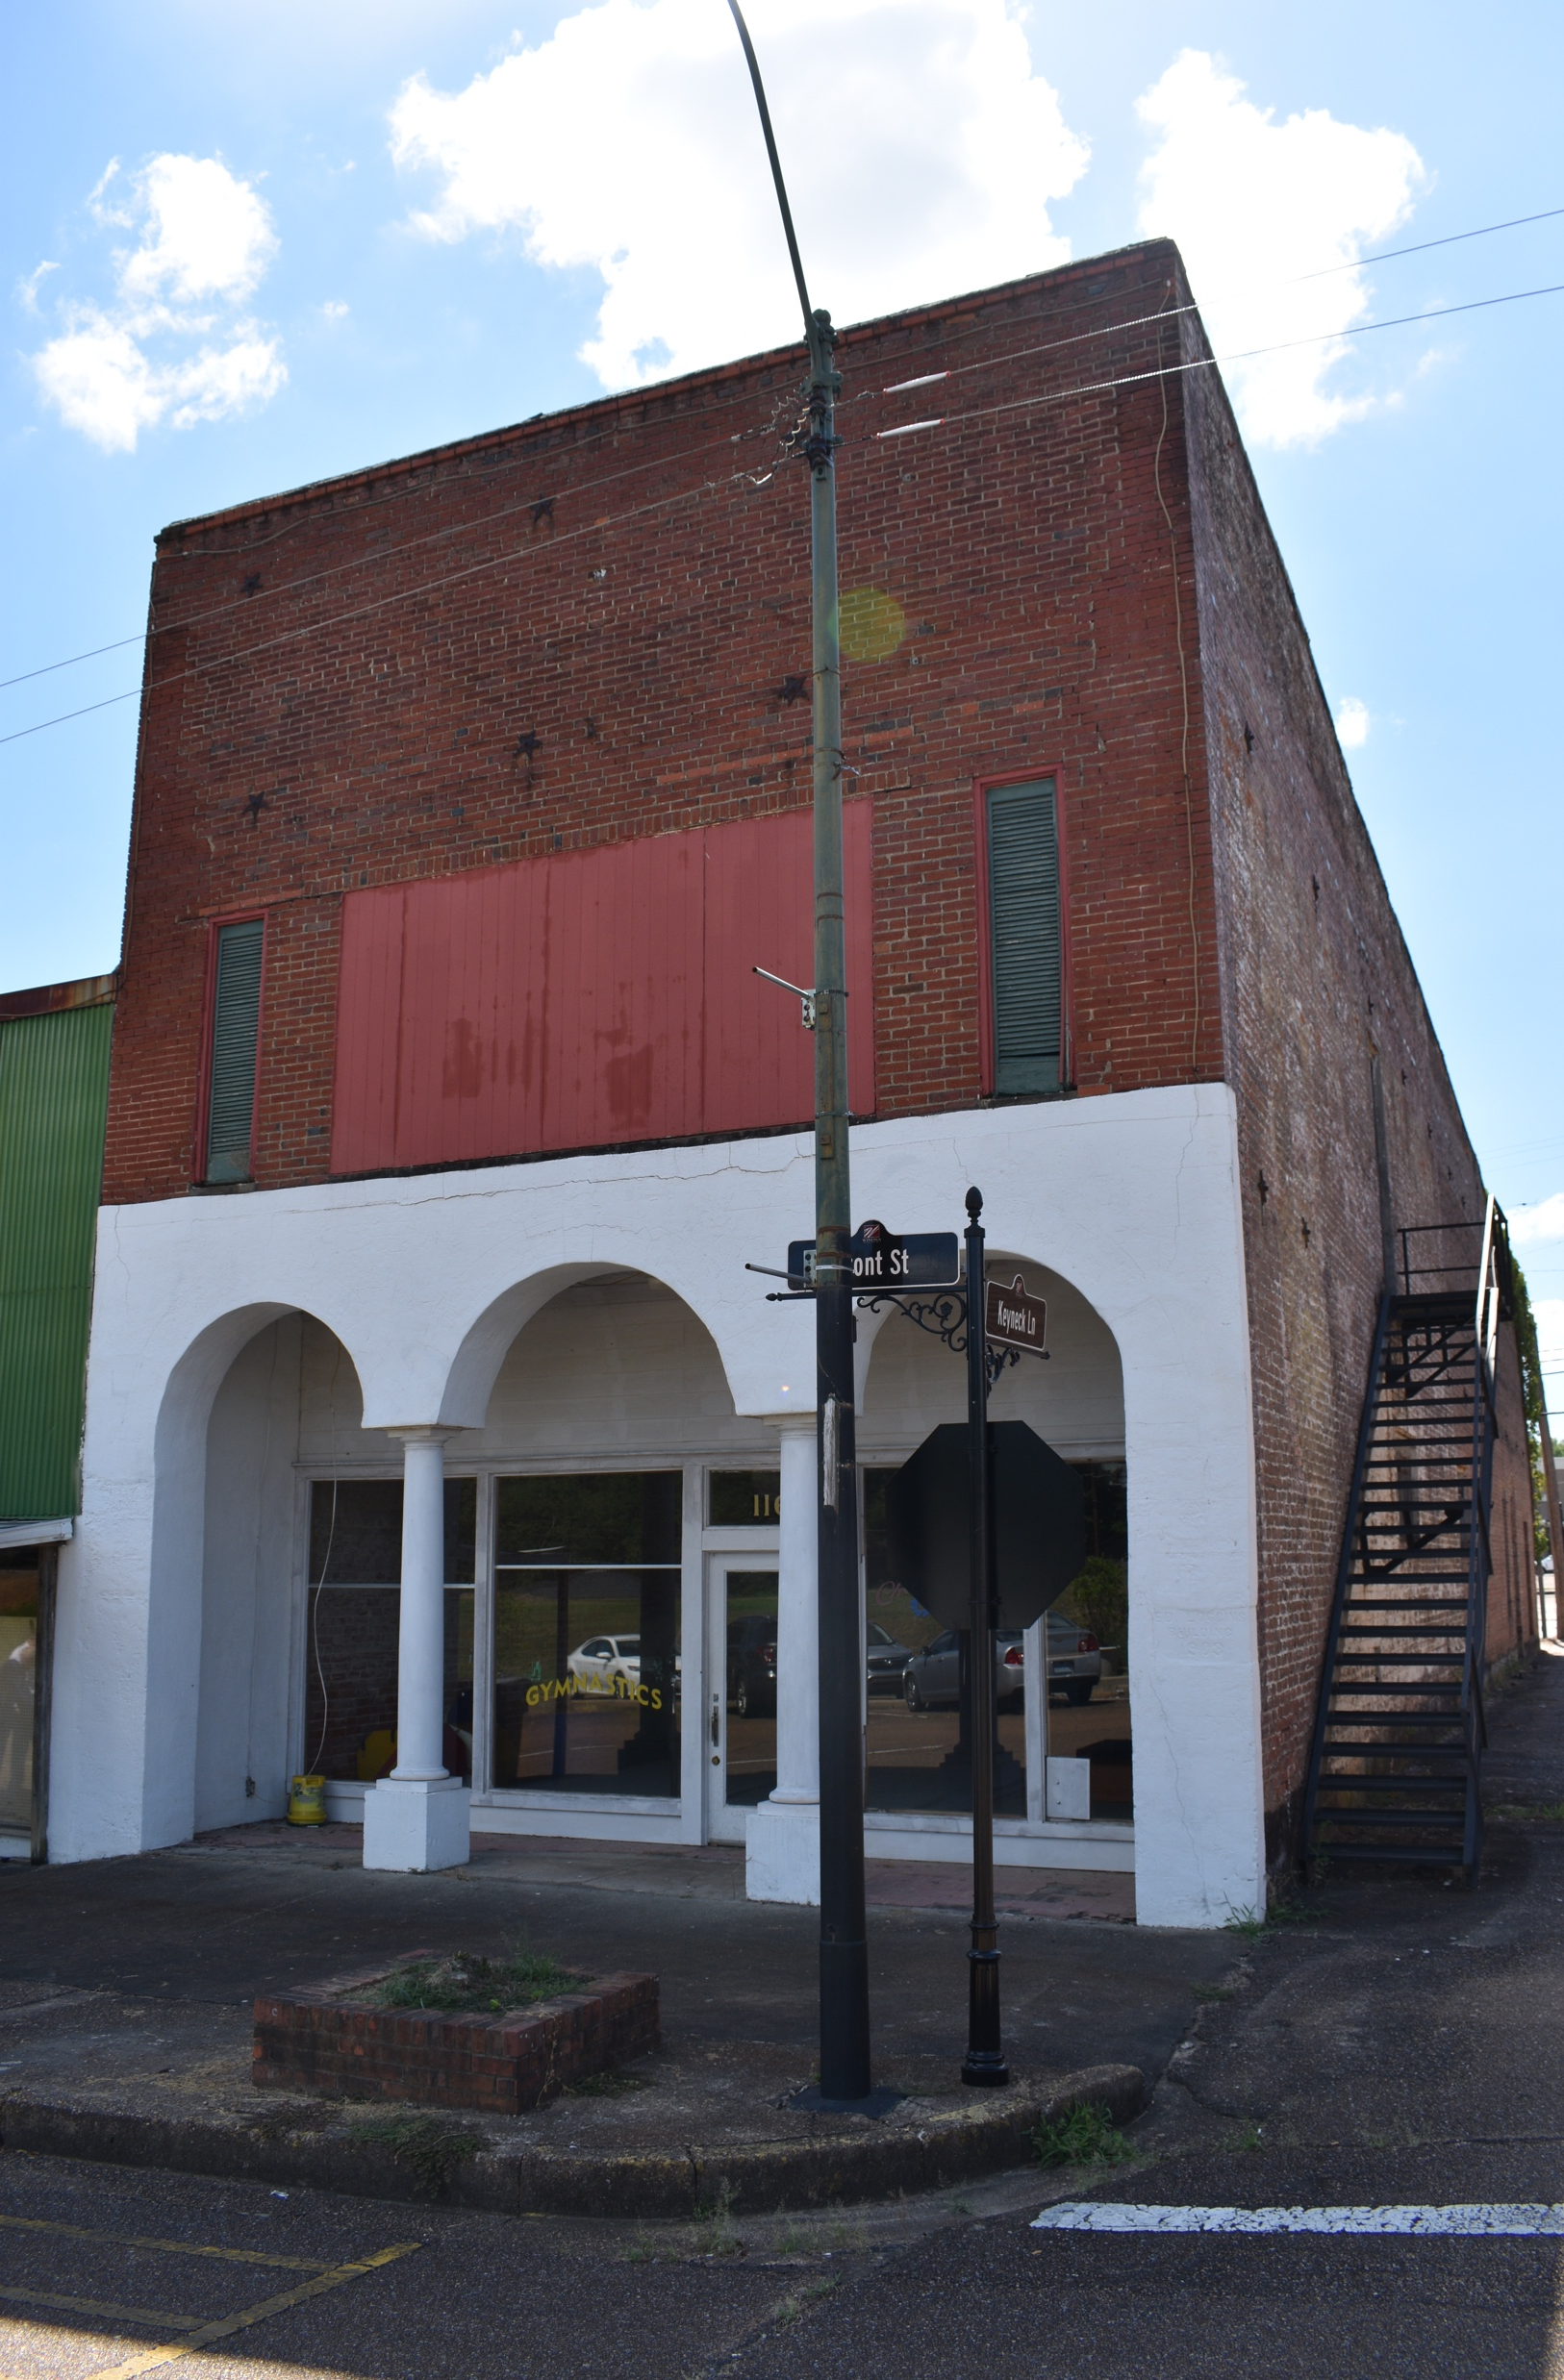
One of Flake’s 3 businesses - a carriage repair shop

Slide 9
A second business owned by Flake…a clothing store once stood where the vacant lot is now

Slide 11
Flake’s home in Winona, MS

Slide 12
Buried with his wife’s family in Baldwyn, MS

Slide 13
Flake’s Formula 5 steps for growing the Sunday School

Slide 14
Step 1: Know your Possibilities
Windshield survey
Demographic data
Gaps in your current organization

Slide 15
Step 2: Enlarge the Organization
This is a “paper and pen” exercise
Dream big…let your possibilities for expansion fuel your thinking

Slide 16
Remember the lesson at 2 Kings 4:1-7

Slide 17
To have more oil, they had to Increase the number of containers (v.3)
God filled the containers (vv.5-6)
Everyone needed to be involved (v.3)
The containers only held so much (v.4)
A catalyst was needed (v.3)
When containers ran out, the oil stopped flowing (v.6)

Slide 18
Step 3: Enlist and train workers

Slide 20
“If we ask our people to lead any ministry of the church, we’re responsible to provide them with continual leadership training. If we can’t do this, we have no business asking them to serve, doing both them and the ministry an injustice. Without ongoing training, our recruits will struggle and often fail, and the rest of the ministry will experience the effects in the resulting leadership vacuum” (Building Leaders, p.27).

Slide 21
“Police. Firefighters. Lawyers. Teachers. Realtors. Electricians. Hair stylists. The guy who makes my tuna sandwich. What do they have in common? Their jobs require ongoing training. If you think about it, there is almost no job on the planet that does not require an employee to have regular, ongoing training. Why is it that we recruit teachers to lead Bible study groups but do not provide regular times of training? In church after church, training has been decreased or eliminated. And we wonder why Sunday School needs a breath of life breathed into it.”
– Breathing Life into Sunday School, p.46

Slide 22
Step 4: Provide space

Slide 23
On Campus

Slide 25
Additional second hour for group ministry?

Slide 26
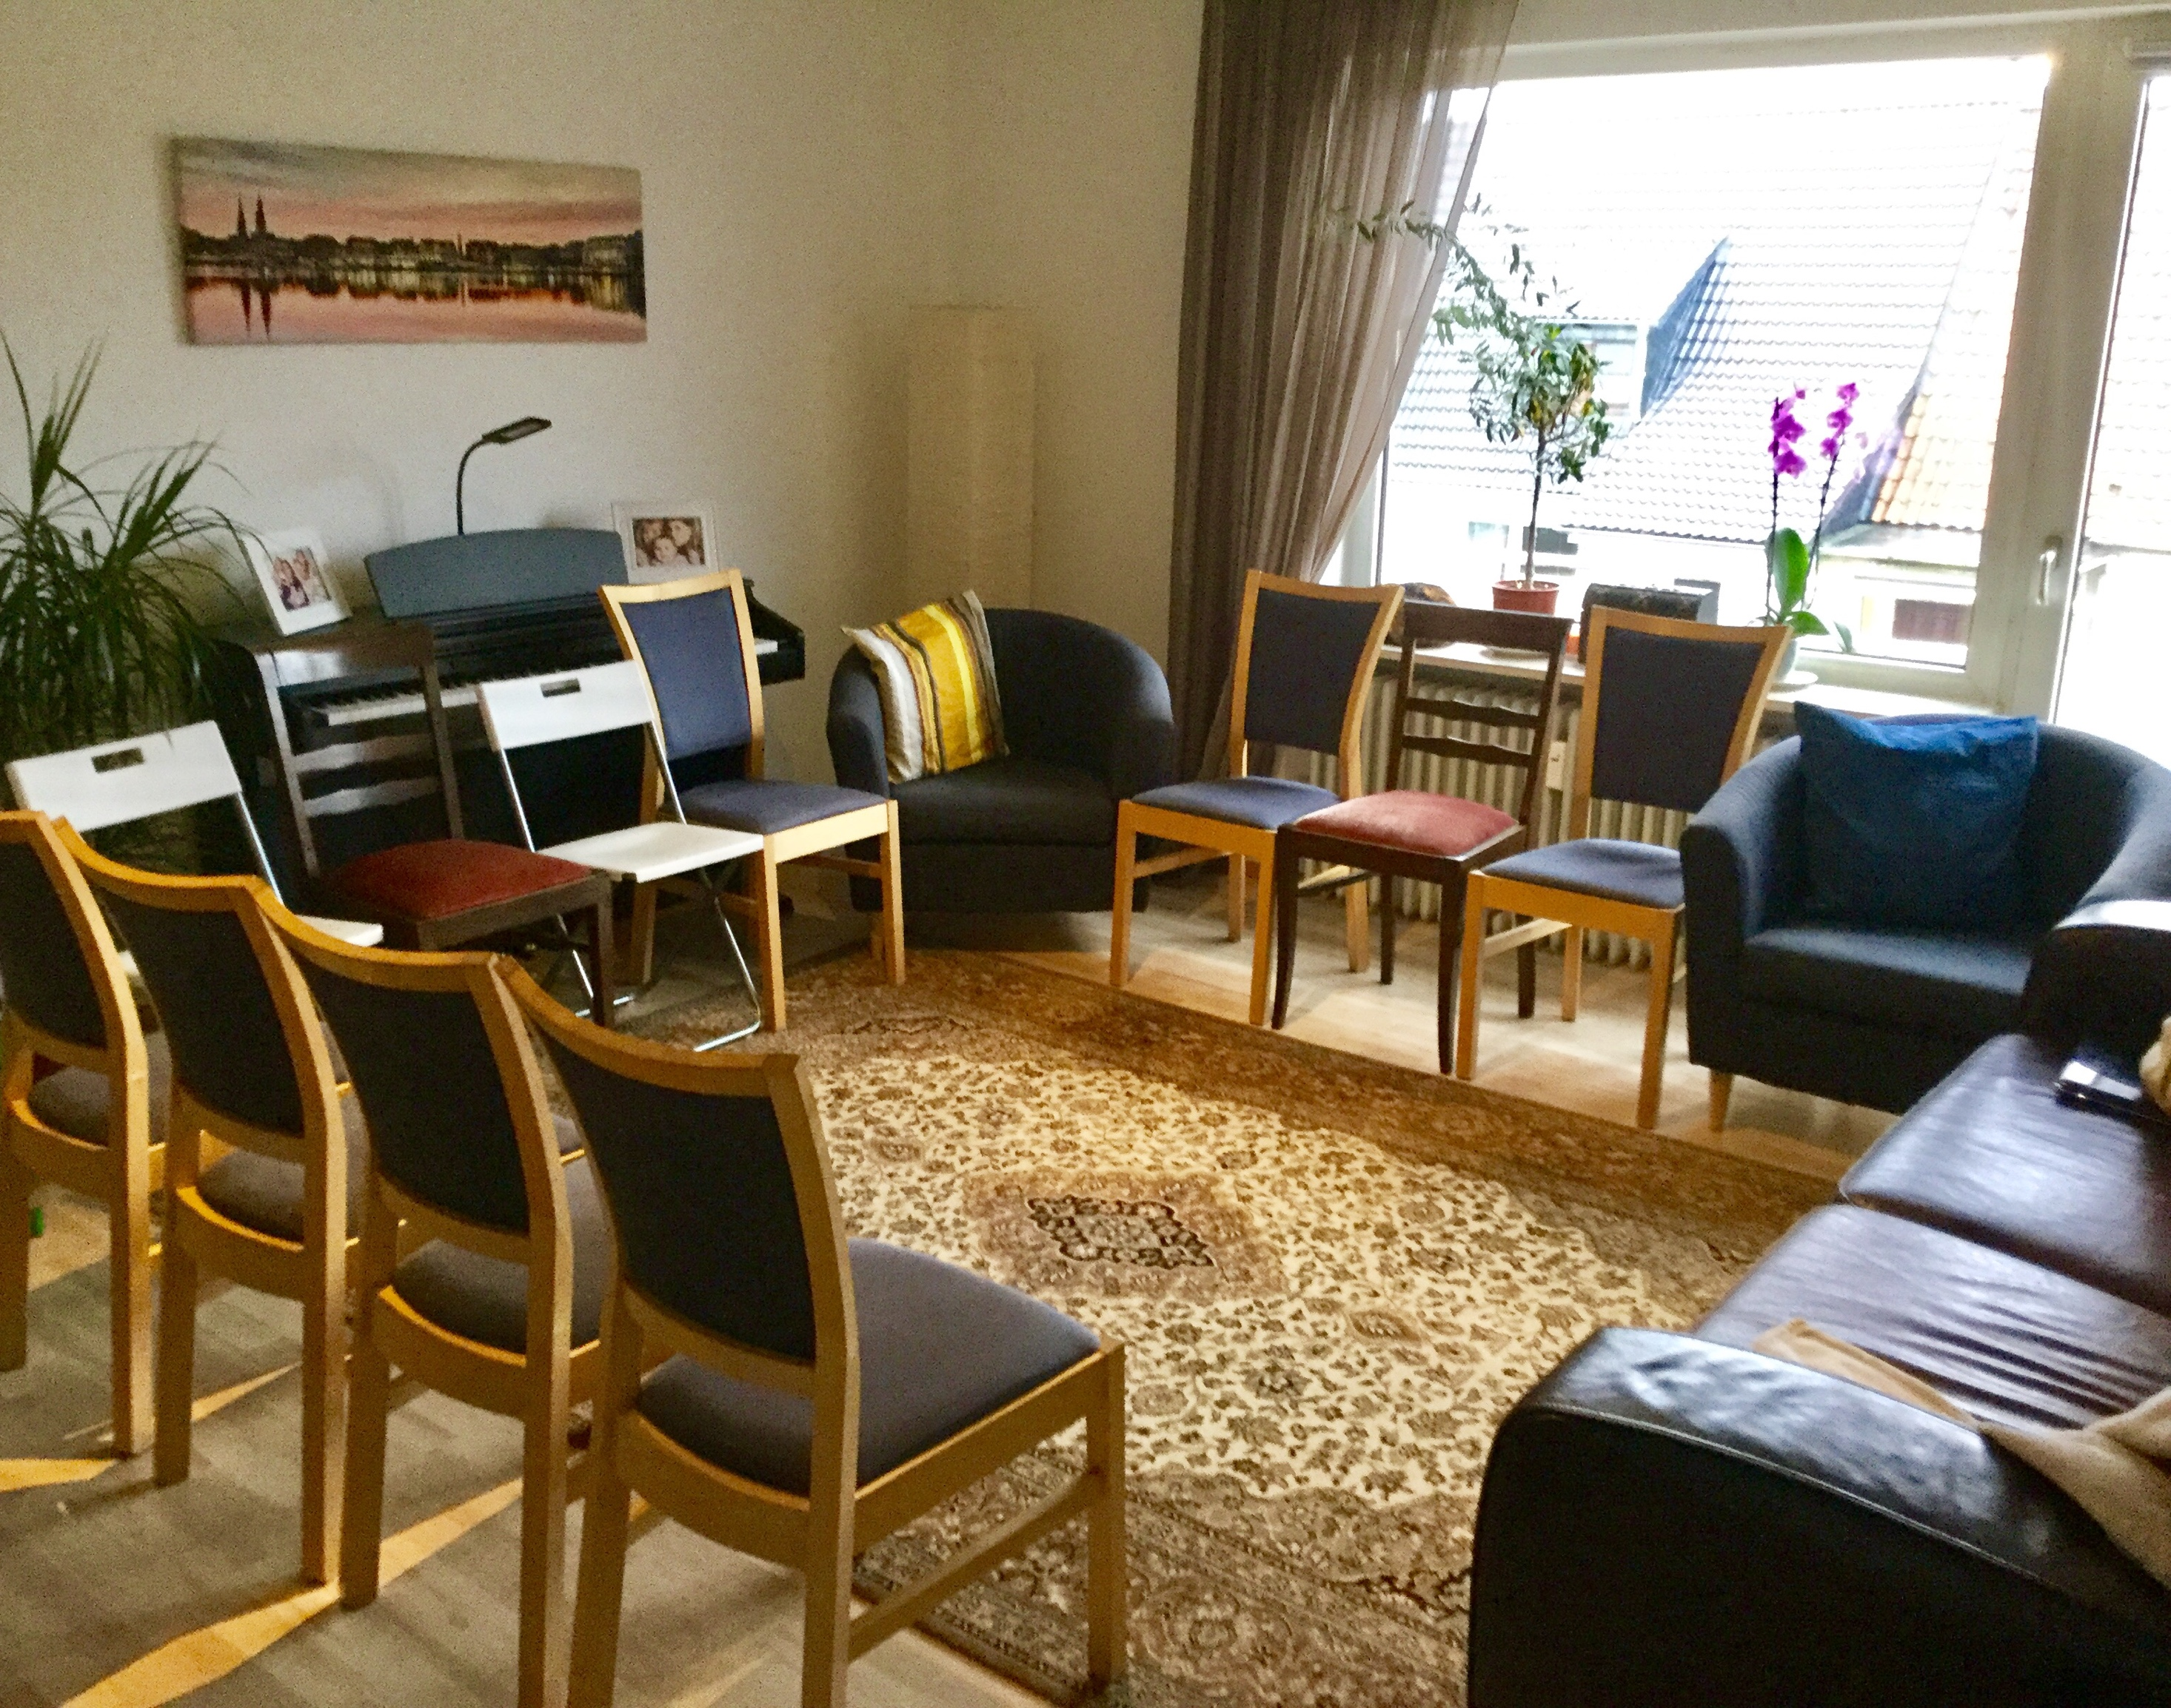
Off Campus

Slide 27
Weekday or weeknight off campus

Slide 28
Local businesses

Slide 29
Online groups

Slide 30
Step 5: Go after the people

Slide 31
“The first four steps are the necessary preparation for growth. Actual growth is a result of going after the people who are the prospects”
- Chuck Kelley Jr. , Fuel the Fire p.94

Slide 32
Released in 2020 on Flake’s 100th anniversary of becoming the SBC’s first Sunday School Superintendent

Slide 33
FLAKE’S FORMULA
Step 1: Know your possibilities
Step 2: Enlarge the organization
Step 3: Enlist and train workers
Step 4: Provide space
Step 5: Go after the people

Slide 34
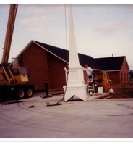
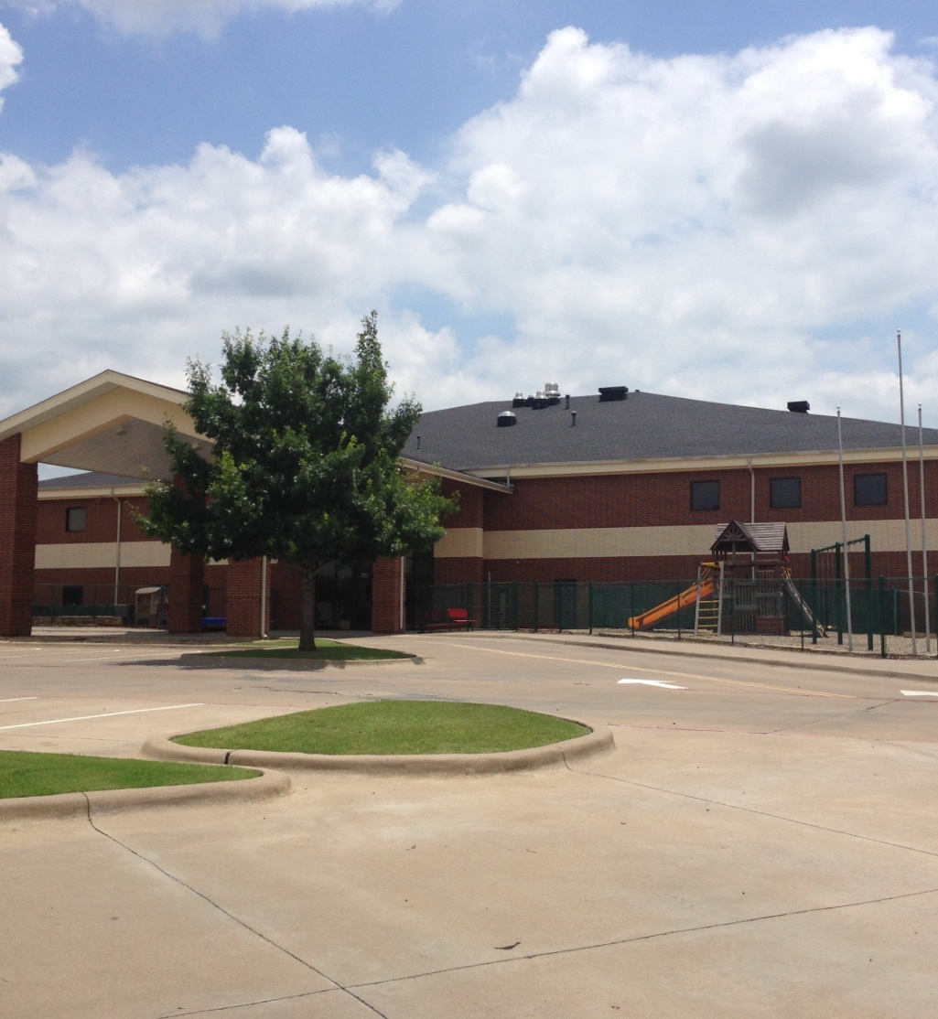

Slide 35
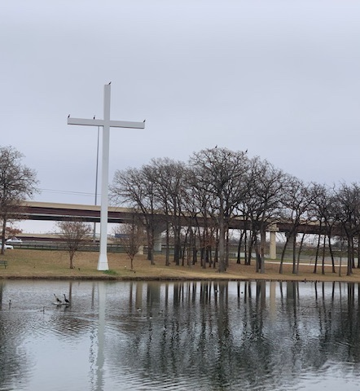
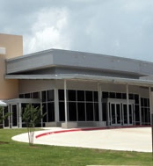

Slide 36
